Slide 1


Slide 2
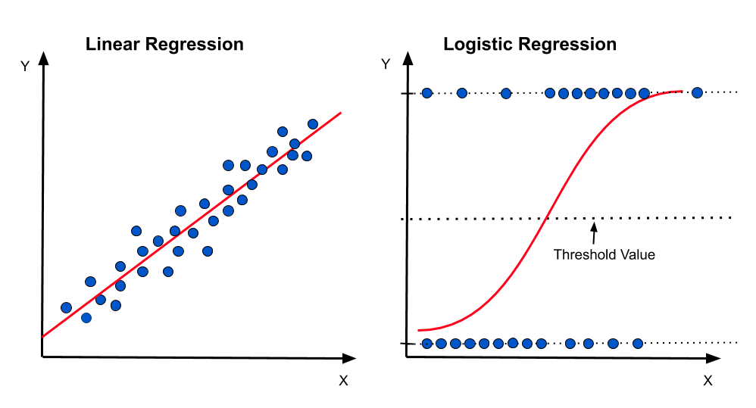














EX:
Passed or not | Number of hours
 | 4
 | 6
 | 2
 | 3
 | 10
 | 7
 | 5
1
0

Slide 3


1
0

Slide 4
1
0

Slide 5
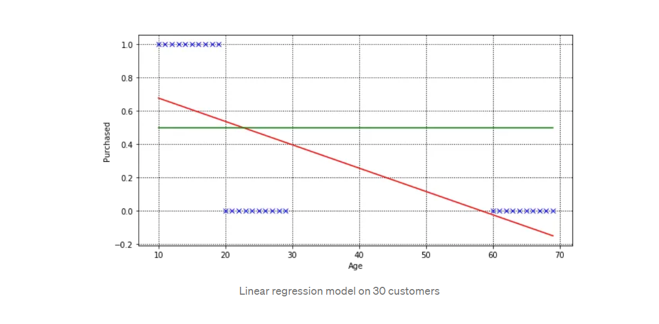

Slide 6
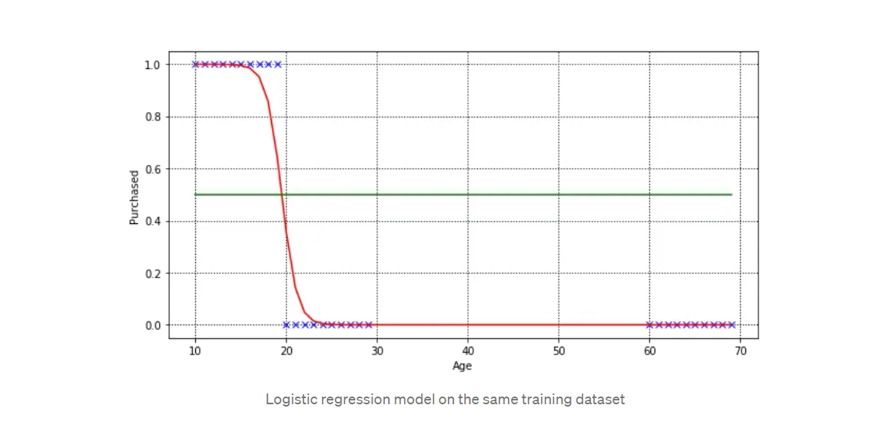

Slide 7
We need a function with some constraints: - positive - less than 1

Slide 8
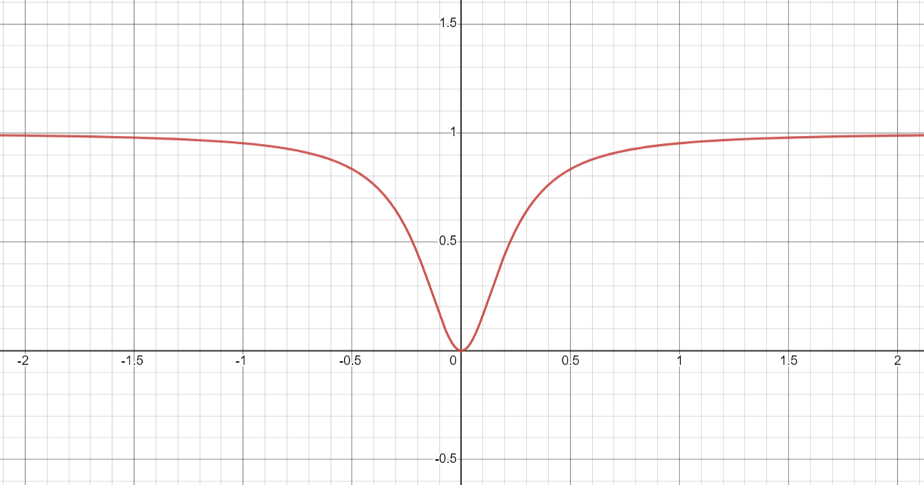

What about quadratic function ($x^{2}$) => $\frac{x^{2}}{x^{2}+1}$

Slide 9

What about quadratic function ($x^{2}$) => $\frac{x^{2}}{x^{2}+1}$
1
0

Slide 10
Now we need a function with some constraints: - positive - less than 1 - not symetric

Slide 11
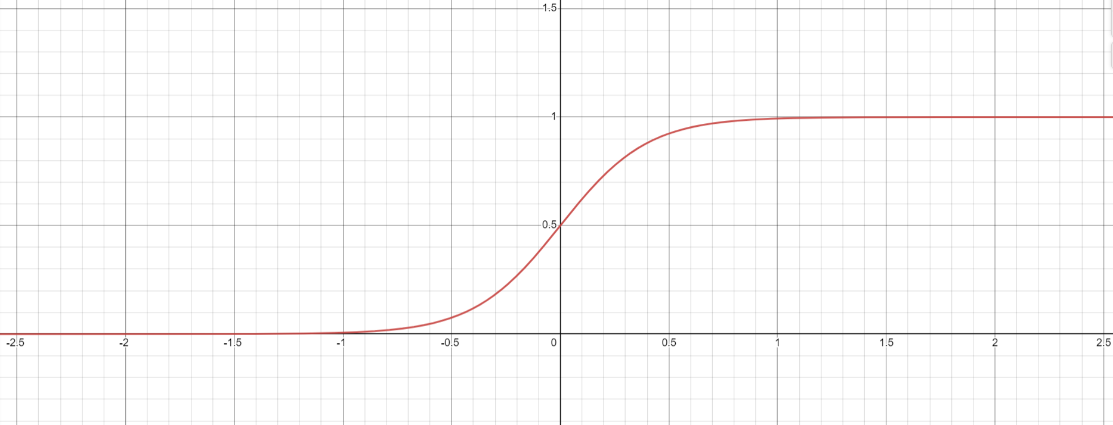

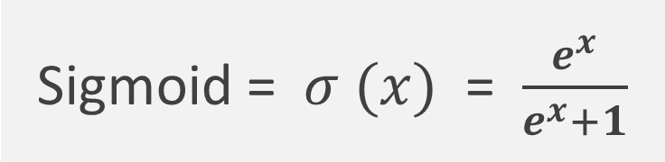
This function is the exponential function ($e^{x}$) => $\frac{e^{x}}{e^{x}+1}$
Sigmoid = $σ (x)$ = $\frac{e^{x}}{e^{x}+1}$

Slide 12

This function is the exponential function ($e^{x}$) => $\frac{e^{x}}{e^{x}+1}$

Slide 13
Let’s derive the Cost Function

Slide 14
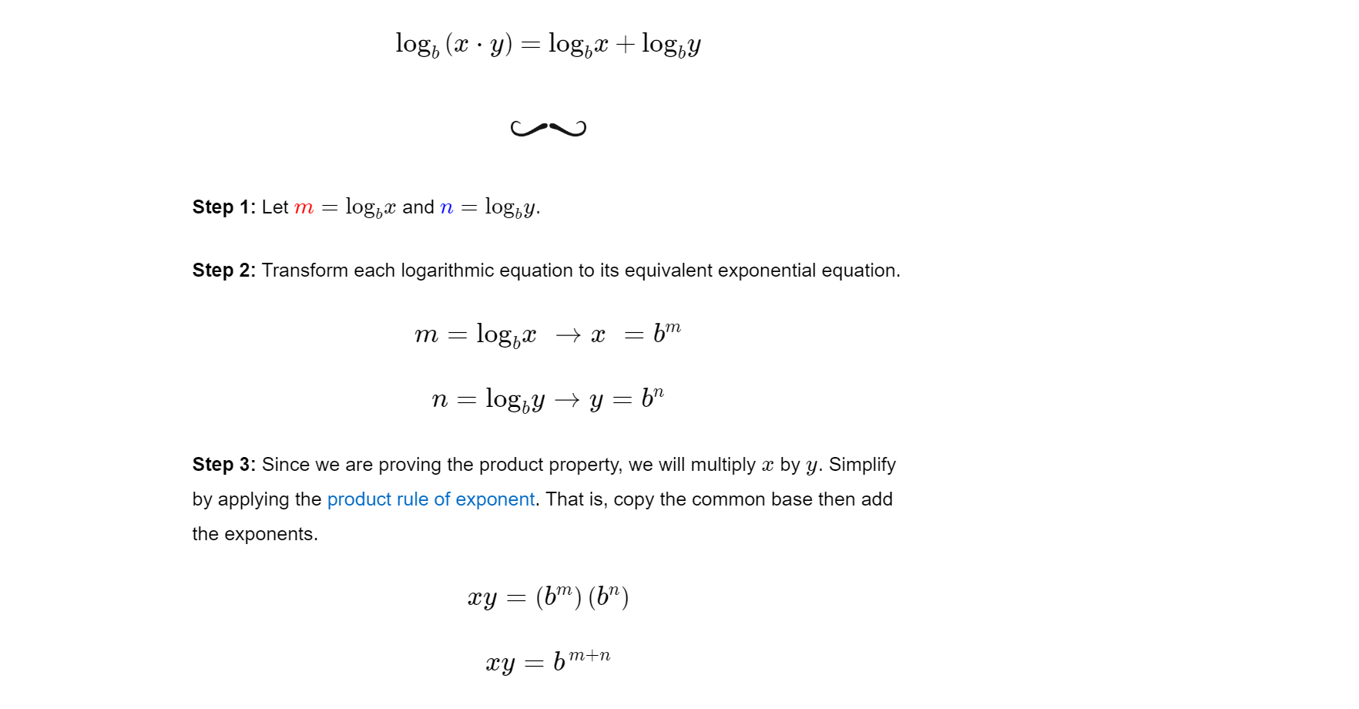

Slide 15
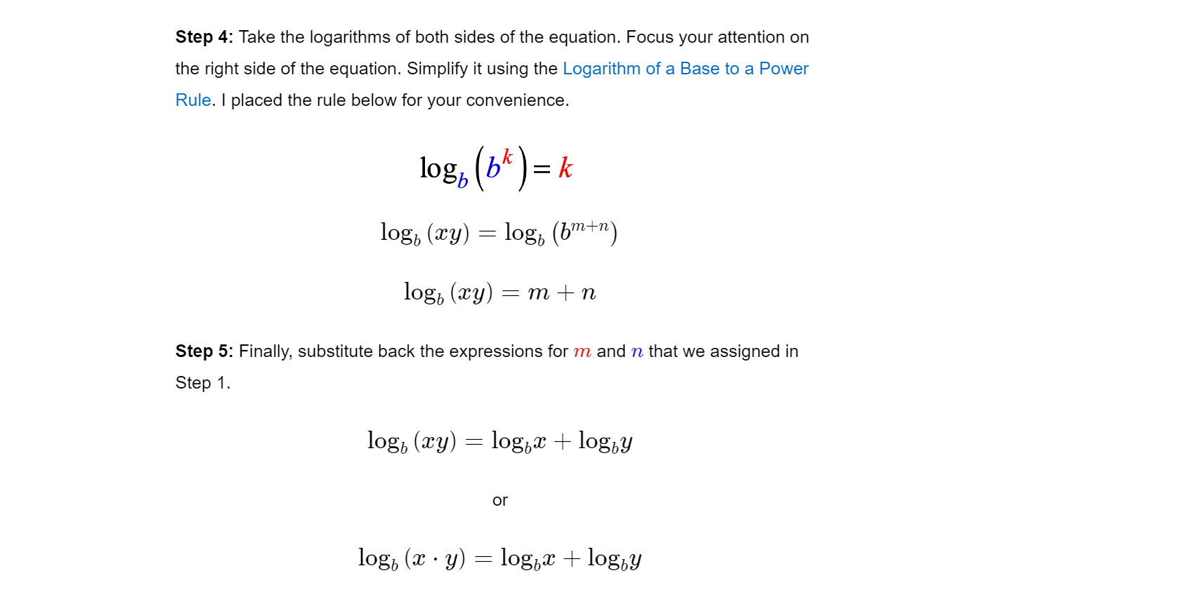

Slide 16
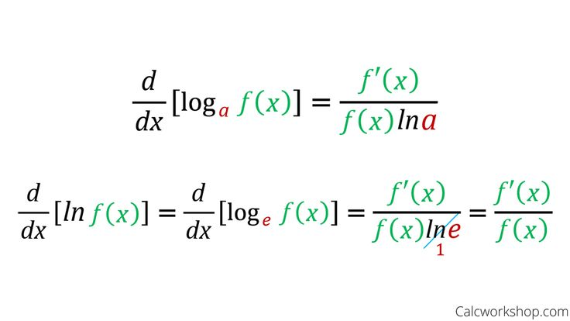

Slide 17
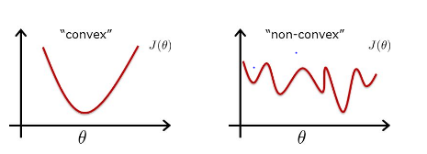
If we use : (real data – the prediction), the output will be a non-convex function, and then we can’t use the derivative and therefore we can’t use the grediant descent.

Slide 18
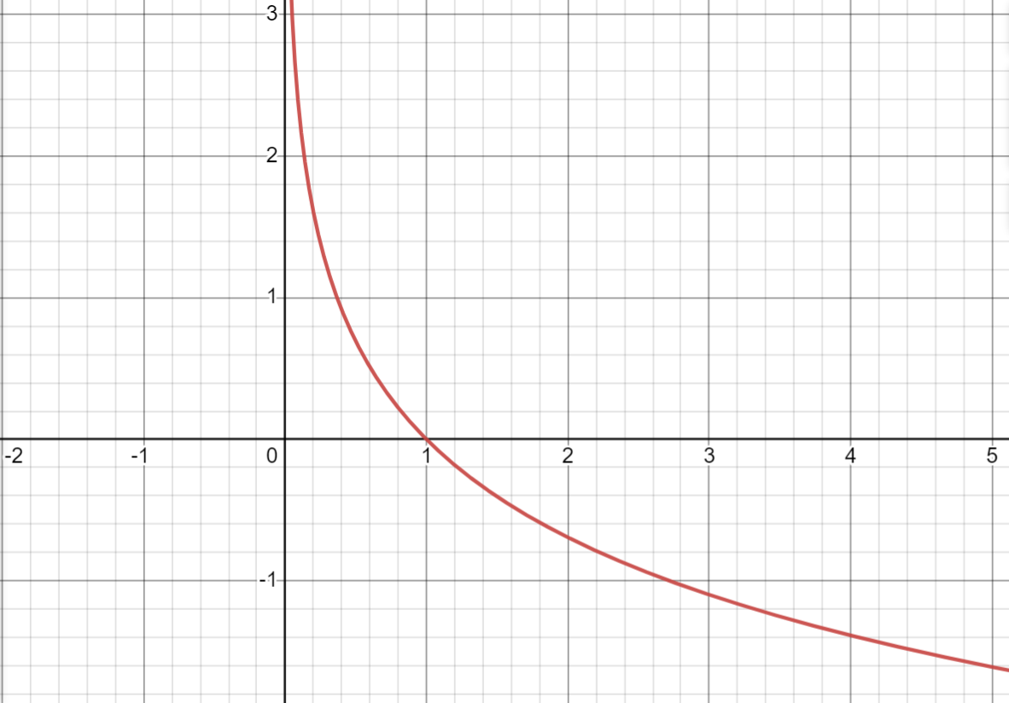
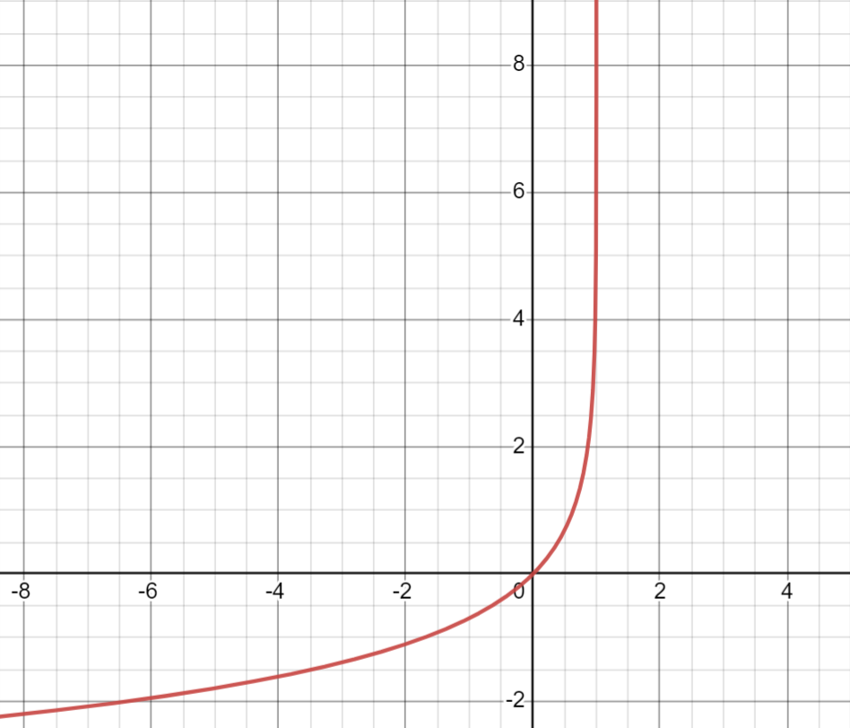
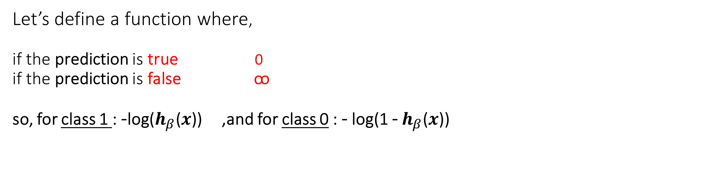
Let’s define a function where, if the prediction is true 0 if the prediction is false ꚙ so, for class 1 : -log($h_{β}$($x$)) ,and for class 0 : - log(1 - $h_{β}$($x$))

Slide 19
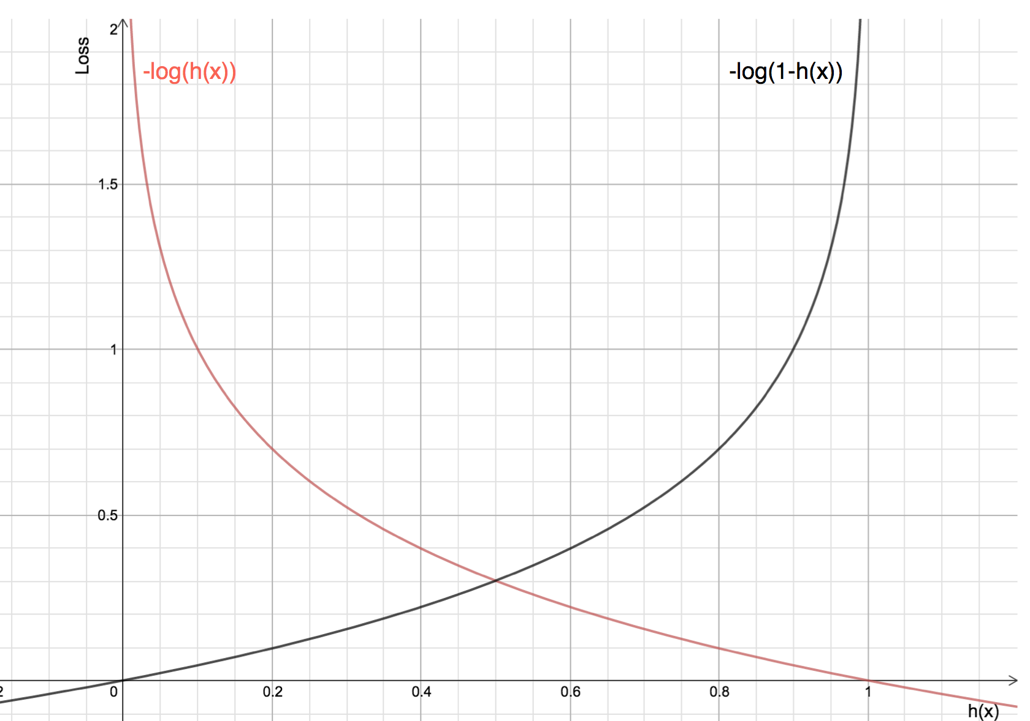
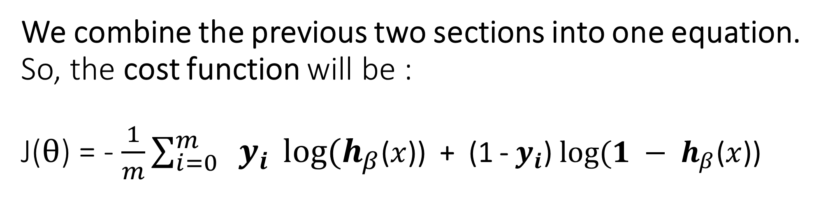
We combine the previous two sections into one equation. So, the cost function will be : J($θ$) = - $\frac{1}{m}$ $\sum_{i=0}^{m}{ y_{i}} log⁡(h_{β}$($x$)) + (1 - $y_{i}$) $log⁡(1 − h_{β}$($x$))

Slide 20
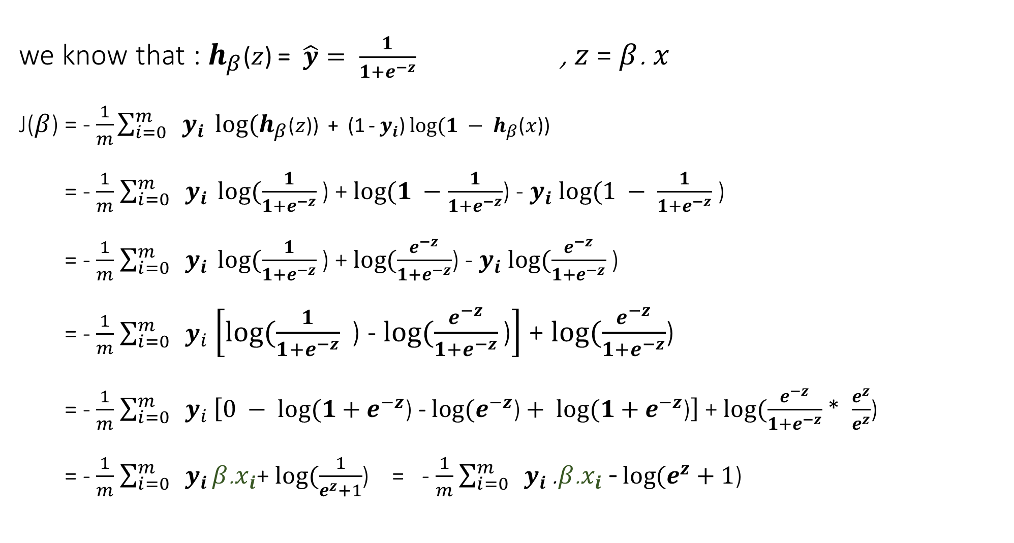

we know that : $h_{β}$($z$) = $\hat{y}= \frac{1}{1+e^{−z}}$ , $z$ = $β$. $x$ J($β$) = - $\frac{1}{m}$ $\sum_{i=0}^{m}{ y_{i}} log⁡(h_{β}$($z$)) + (1 - $y_{i}$) $log⁡(1 − h_{β}$($x$)) = - $\frac{1}{m}$ $\sum_{i=0}^{m}{ y_{i}} log⁡(\frac{1}{1+e^{−z}}$ ) + $log⁡(1 −\frac{1}{1+e^{−z}}$) - $y_{i} log⁡(1 − \frac{1}{1+e^{−z}}$ ) = - $\frac{1}{m}$ $\sum_{i=0}^{m}{ y_{i}} log⁡(\frac{1}{1+e^{−z}}$ ) + $log⁡(\frac{e^{−z}}{1+e^{−z}}$) - $y_{i} log⁡(\frac{e^{−z}}{1+e^{−z}}$ ) = - $\frac{1}{m}$ $\sum_{i=0}^{m}{ y_{i}}$ $\left[log⁡(\frac{1}{1+e^{−z}}\text{ ) }\text{−} log⁡(\frac{e^{−z}}{1+e^{−z}}\text{)}\right]$ + $log⁡(\frac{e^{−z}}{1+e^{−z}}$) = - $\frac{1}{m}$ $\sum_{i=0}^{m}{ y_{i}}$ $\left[0 − log⁡(1+e^{−z}\text{) }\text{−} log⁡(e^{−z}\text{)}+ log⁡(1+e^{−z}\text{)}\right]$ + $log⁡(\frac{e^{−z}}{1+e^{−z}}$ * $\frac{e^{z}}{e^{z}}$) = - $\frac{1}{m}$ $\sum_{i=0}^{m}{ y_{i}}β\text{.}x_{i}$+ $log⁡(\frac{1}{e^{z}+1}$) = - $\frac{1}{m}$ $\sum_{i=0}^{m}{ y_{i}}\text{.}β\text{.}x_{i}$ - $log⁡(e^{z}+1$)
(1)

Slide 21

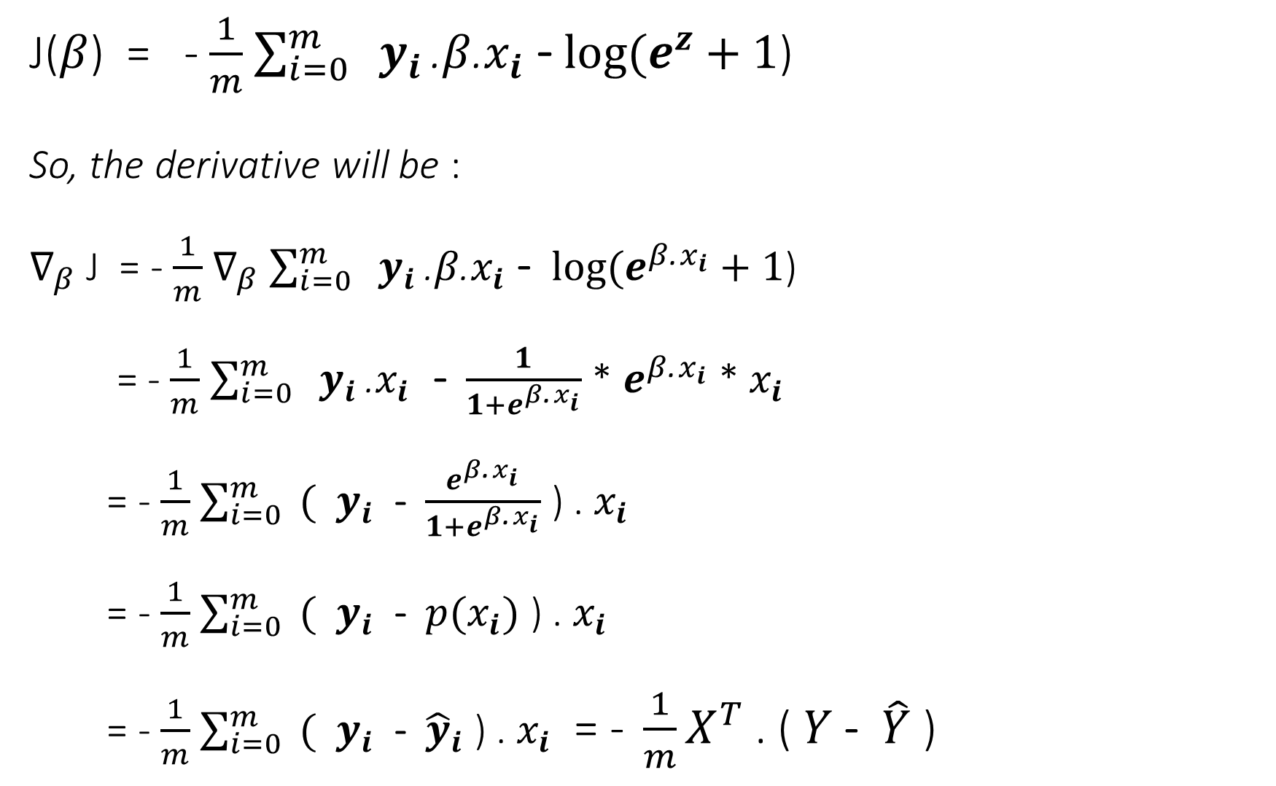
J($β$) = - $\frac{1}{m}$ $\sum_{i=0}^{m}{ y_{i}}\text{.}β\text{.}x_{i}$ - $log⁡(e^{z}+1$) So, the derivative will be : $∇_{β}$ J = - $\frac{1}{m}$ $∇_{β}$ $\sum_{i=0}^{m}{ y_{i}}\text{.}β\text{.}x_{i}$ - $log⁡(e^{β\text{.}x_{i}}+1$) = - $\frac{1}{m}$ $\sum_{i=0}^{m}{ y_{i}}\text{.} x_{i}$ - $\frac{1}{1+e^{β\text{.}x_{i}}}$ * $e^{β\text{.}x_{i}}$ * $x_{i}$ = - $\frac{1}{m}$ $\sum_{i=0}^{m}{ ( y_{i}}$ - $\frac{e^{β\text{.}x_{i}}}{1+e^{β\text{.}x_{i}}}$ ) . $x_{i}$ = - $\frac{1}{m}$ $\sum_{i=0}^{m}{ ( y_{i}}$ - $p(x_{i})$ ) . $x_{i}$ = - $\frac{1}{m}$ $\sum_{i=0}^{m}{ ( y_{i}}$ - ${\hat{y}}_{i}$ ) . $x_{i}$ = ${\text{− }\frac{1}{m}X}^{T}$ . ( $Y$- $\hat{Y}$ )
(1)
is a $sigmoid$
for a matrix notation.

Slide 22
Probabilities and OODs

Slide 23
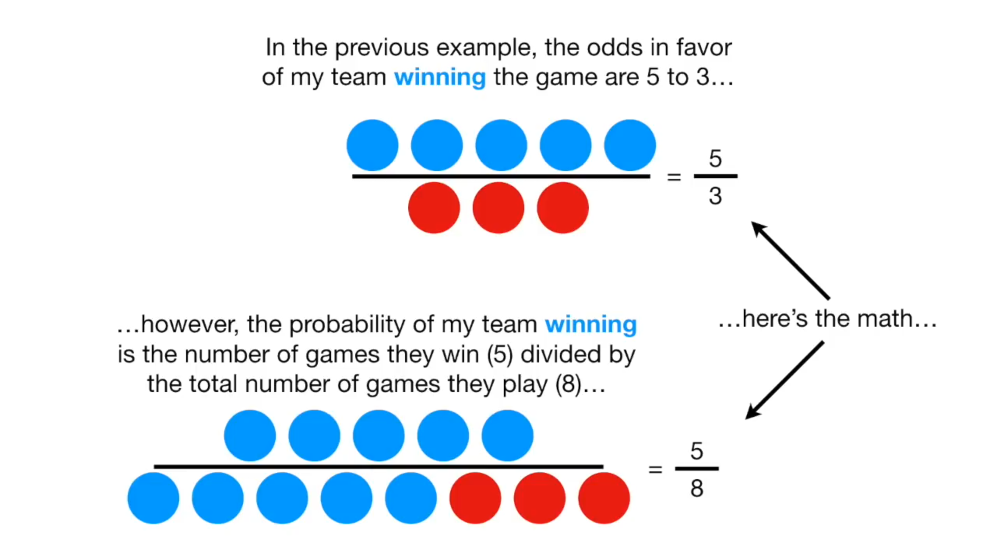



Slide 24
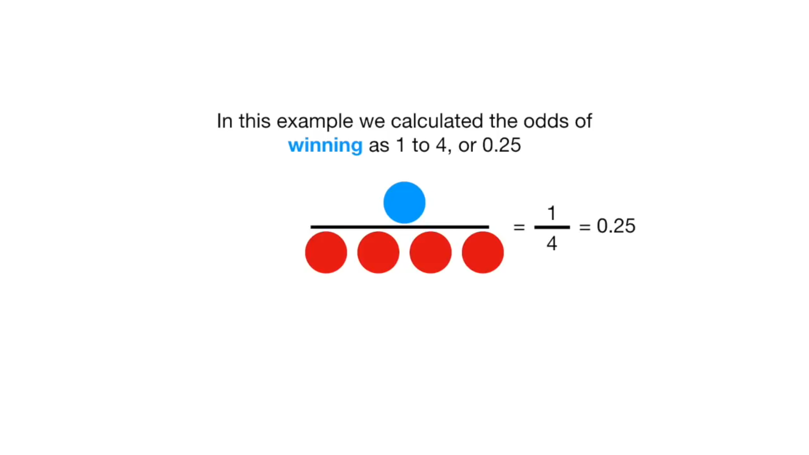

Slide 25
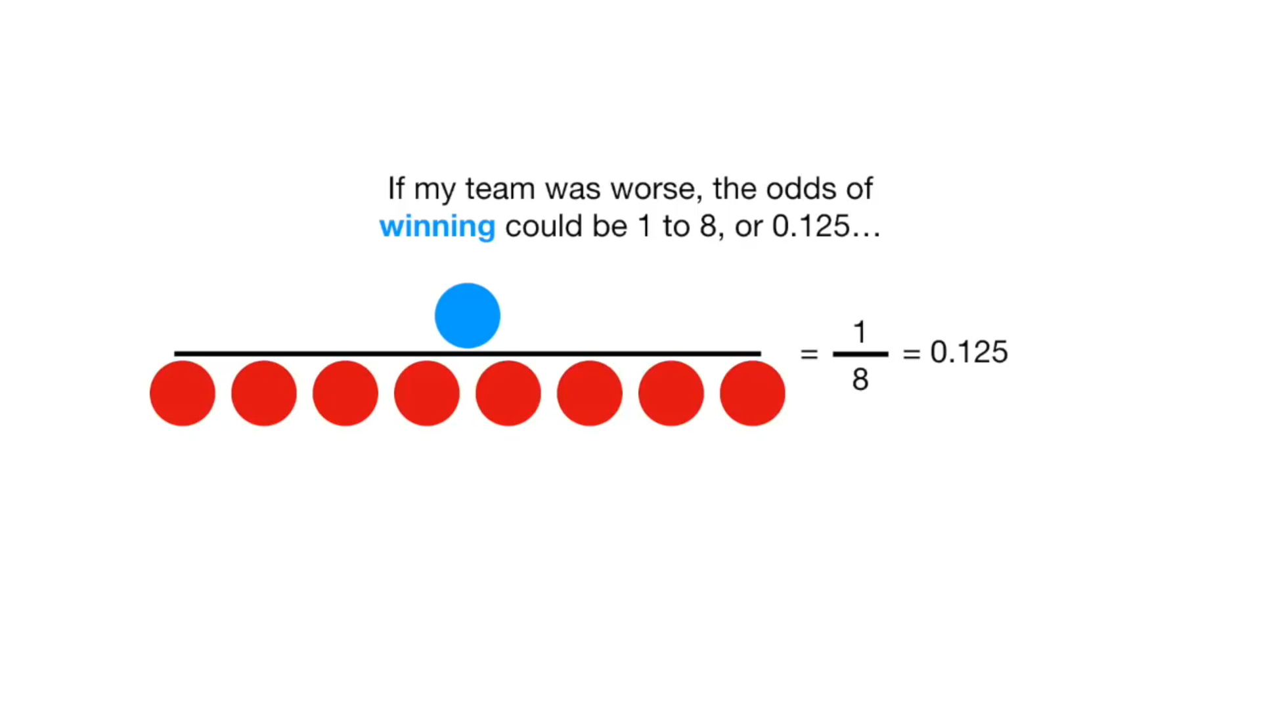

Slide 26
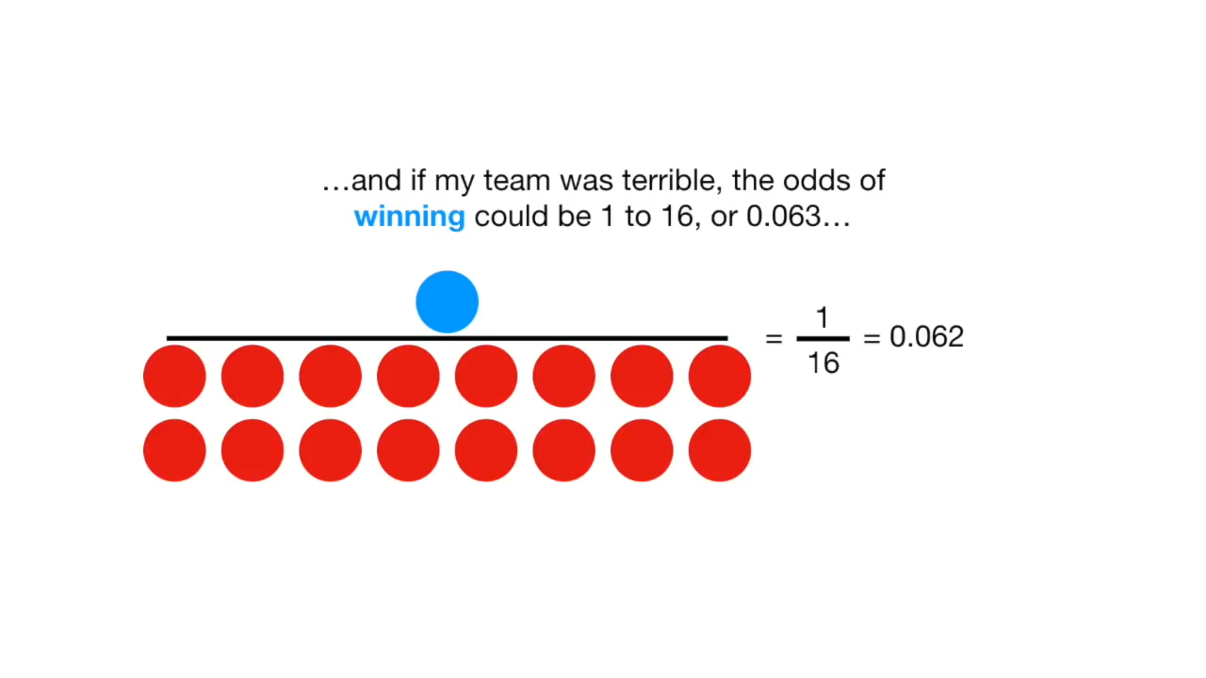

Slide 27
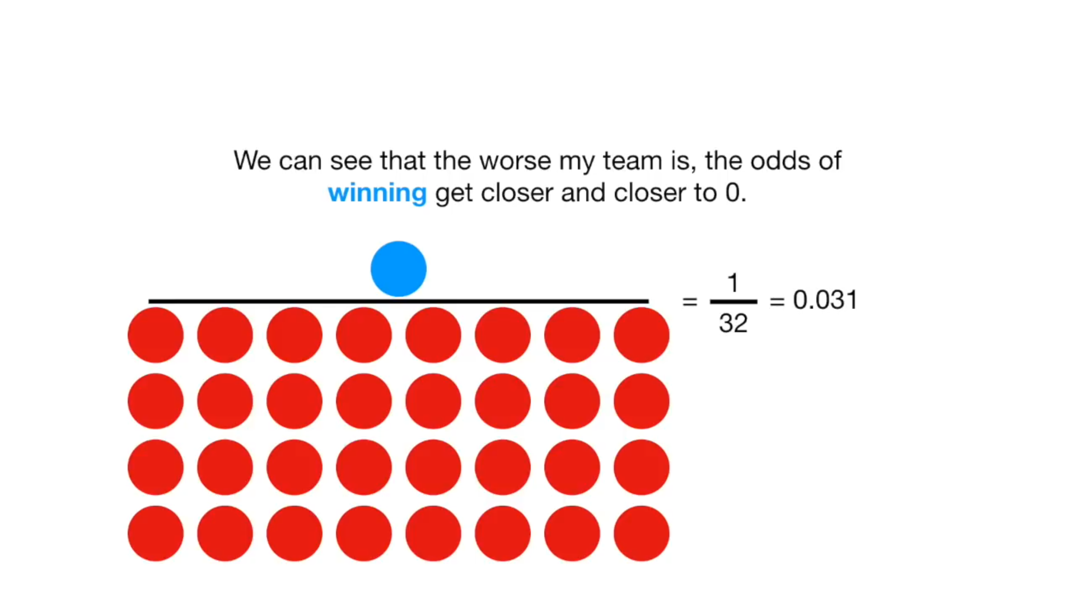

Slide 28
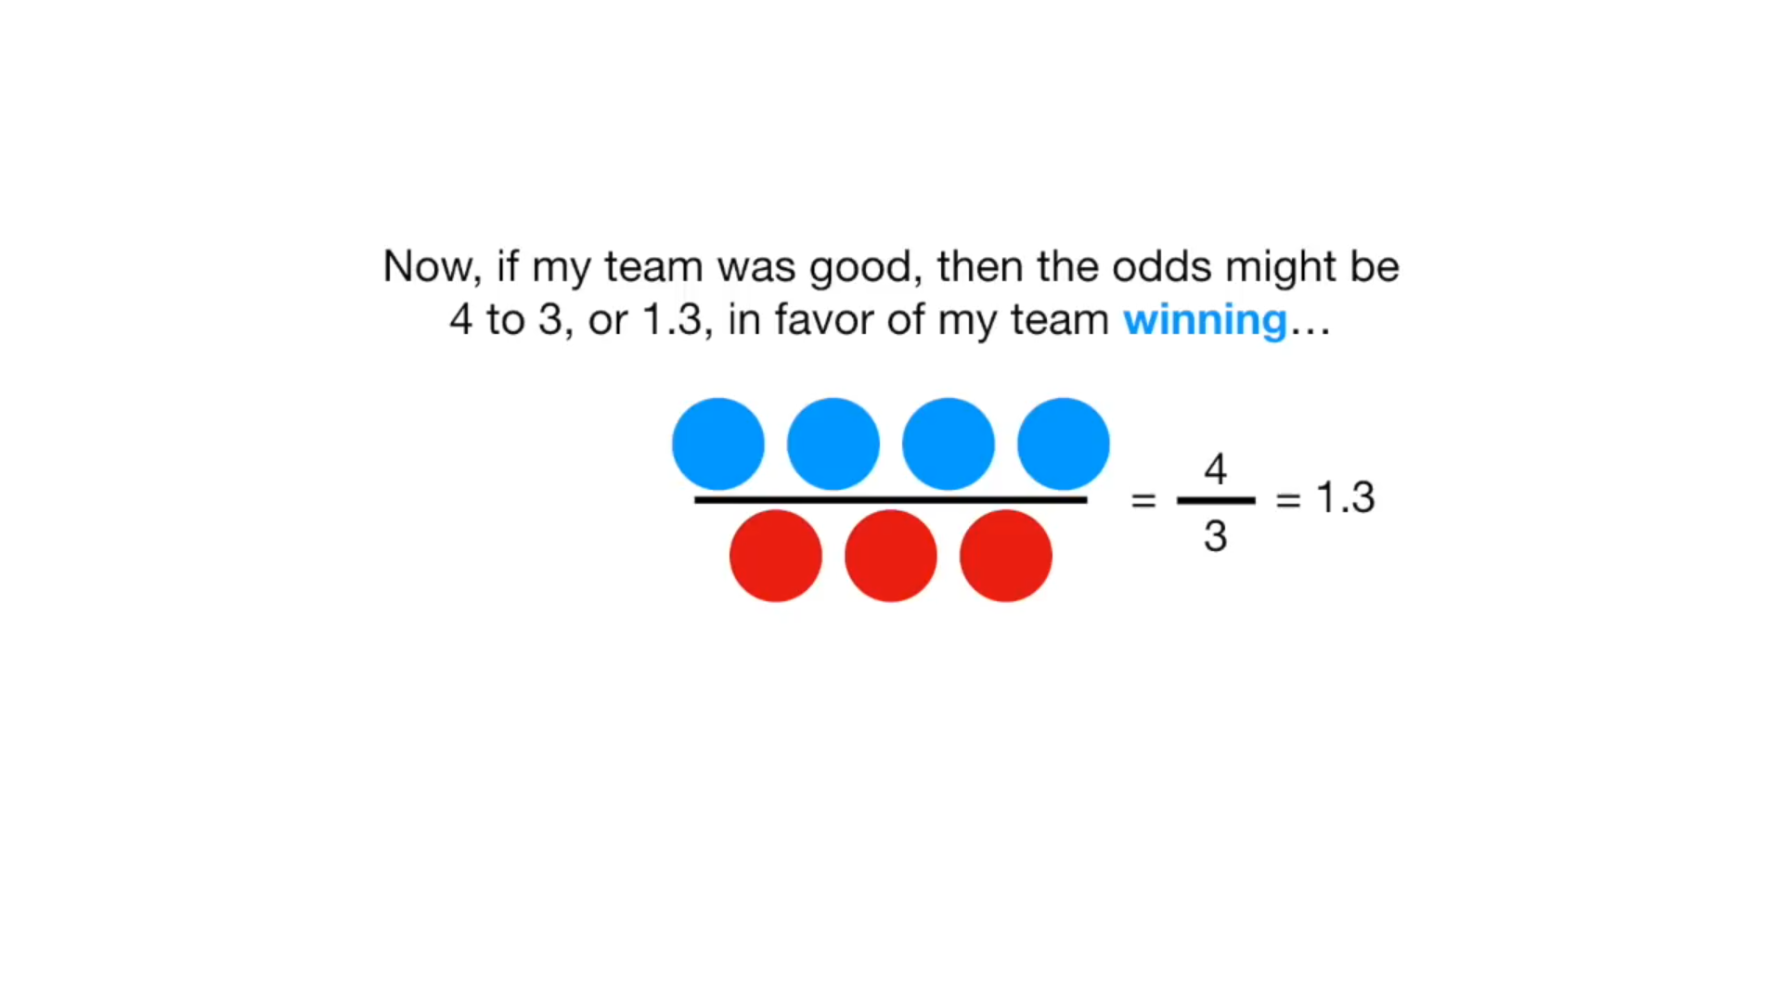

Slide 29
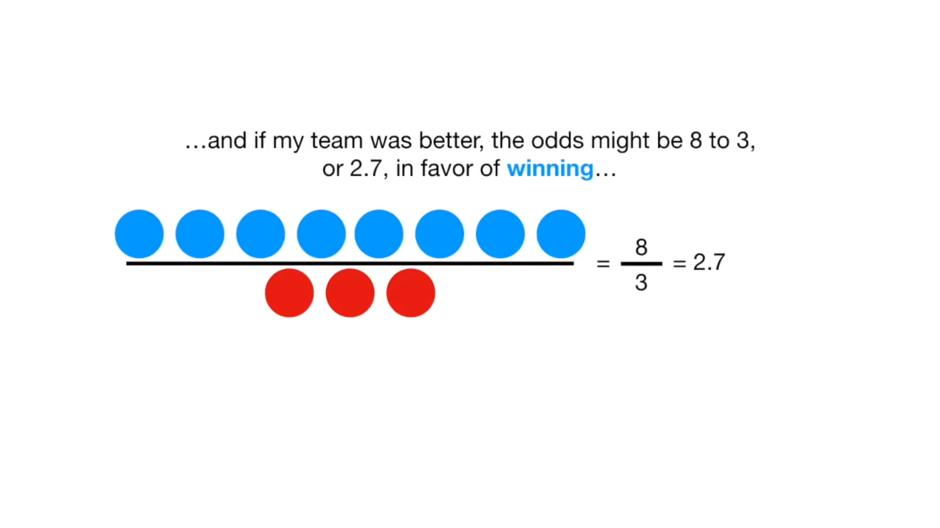

Slide 30
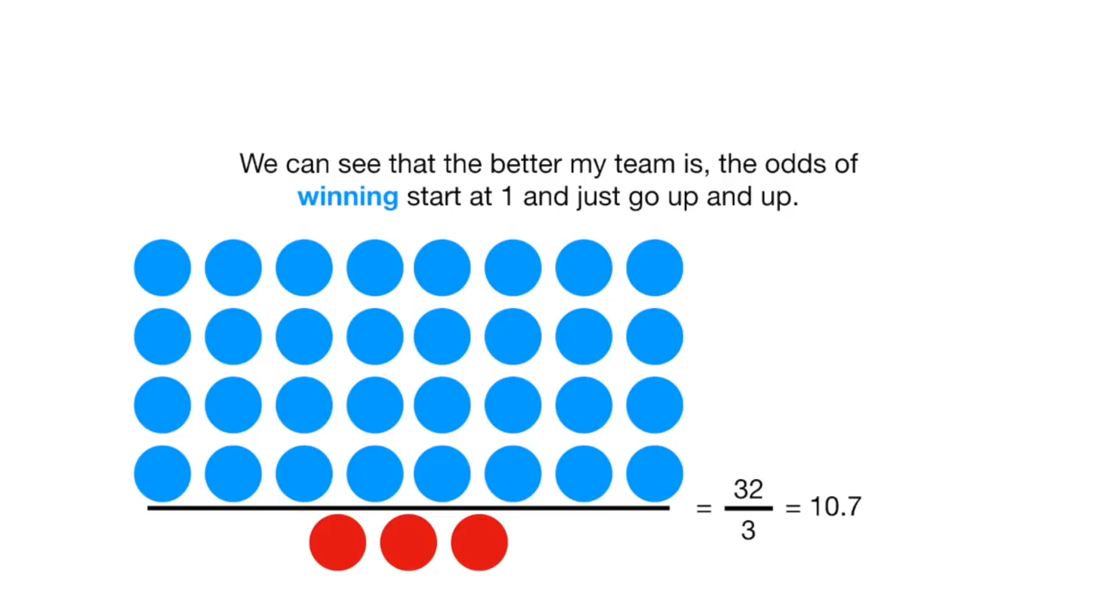

Slide 31
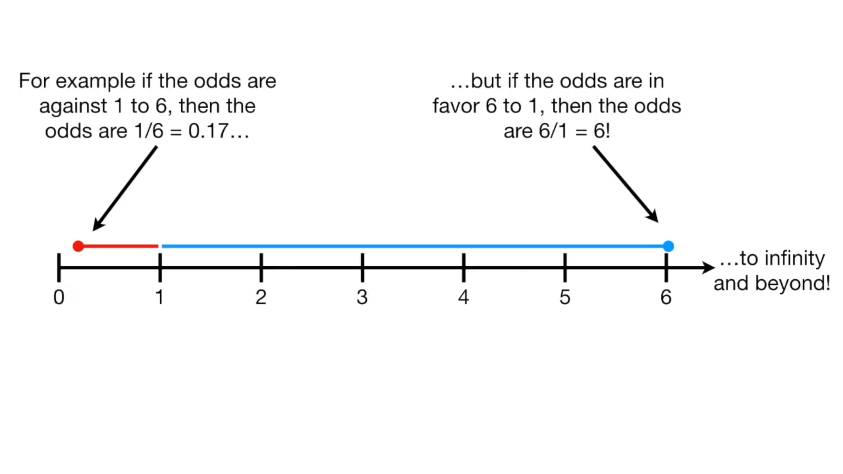

Slide 32
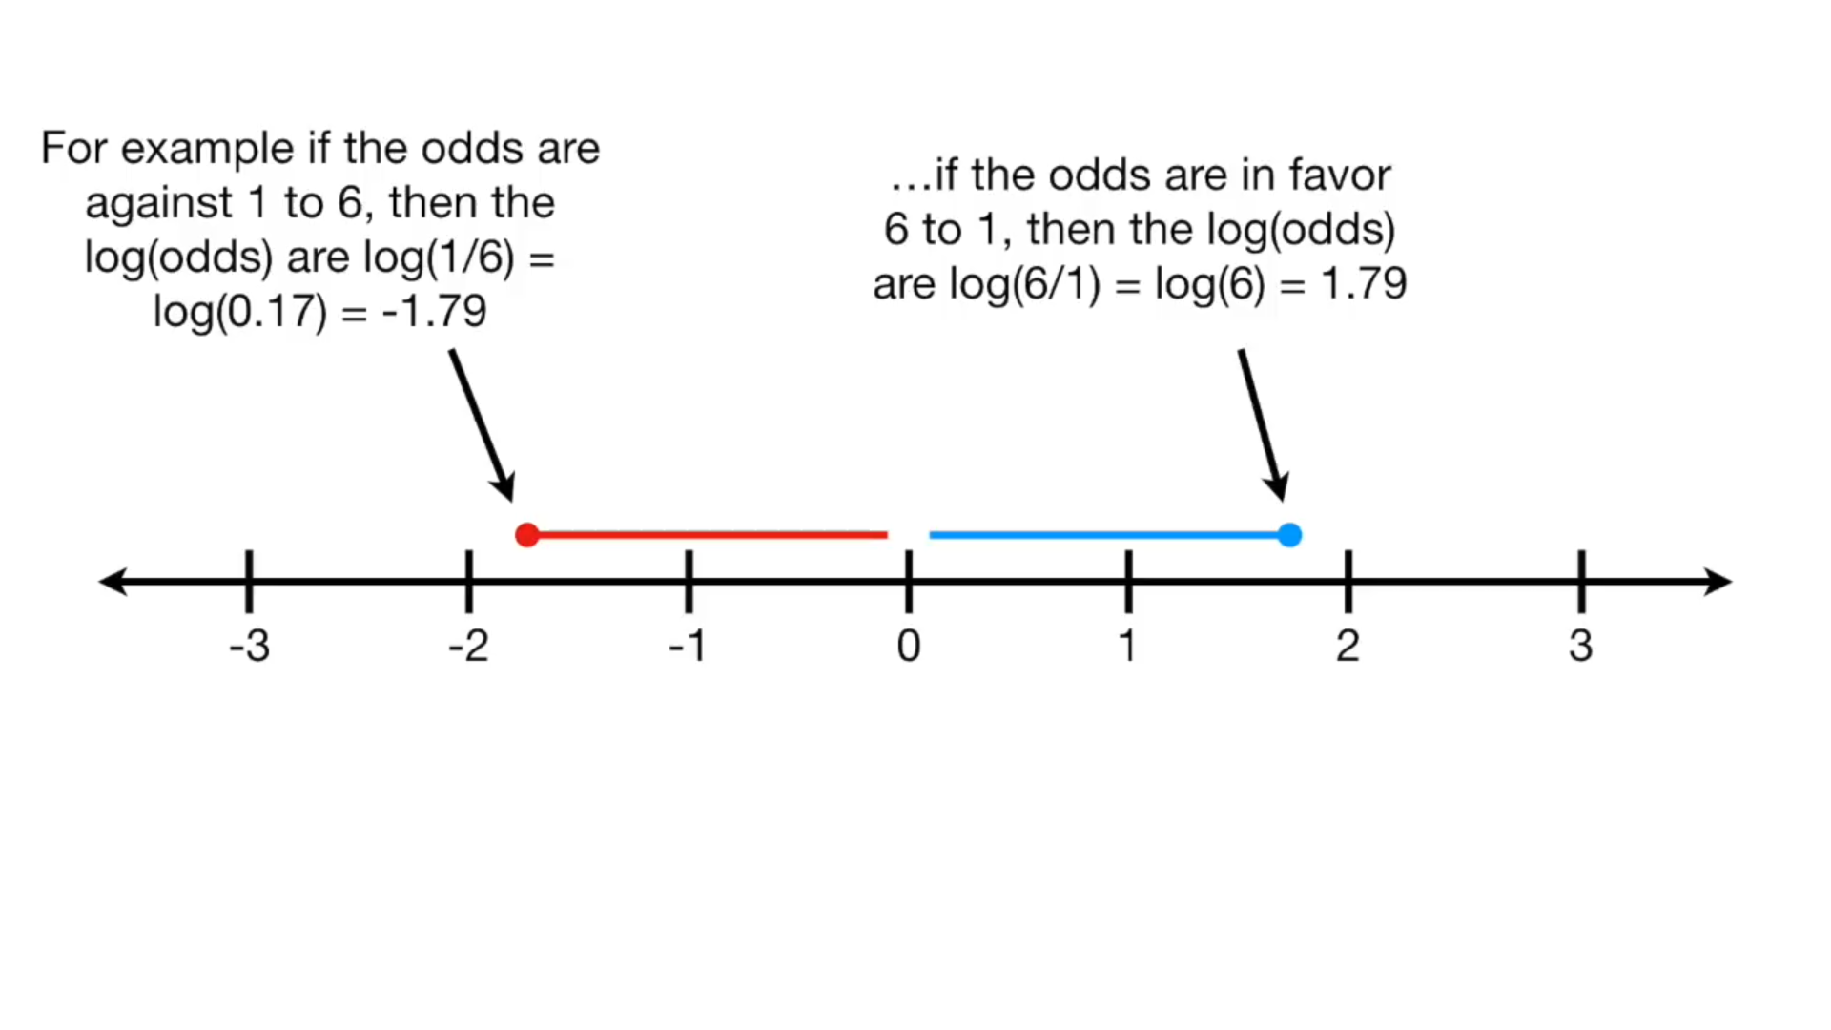

Slide 33
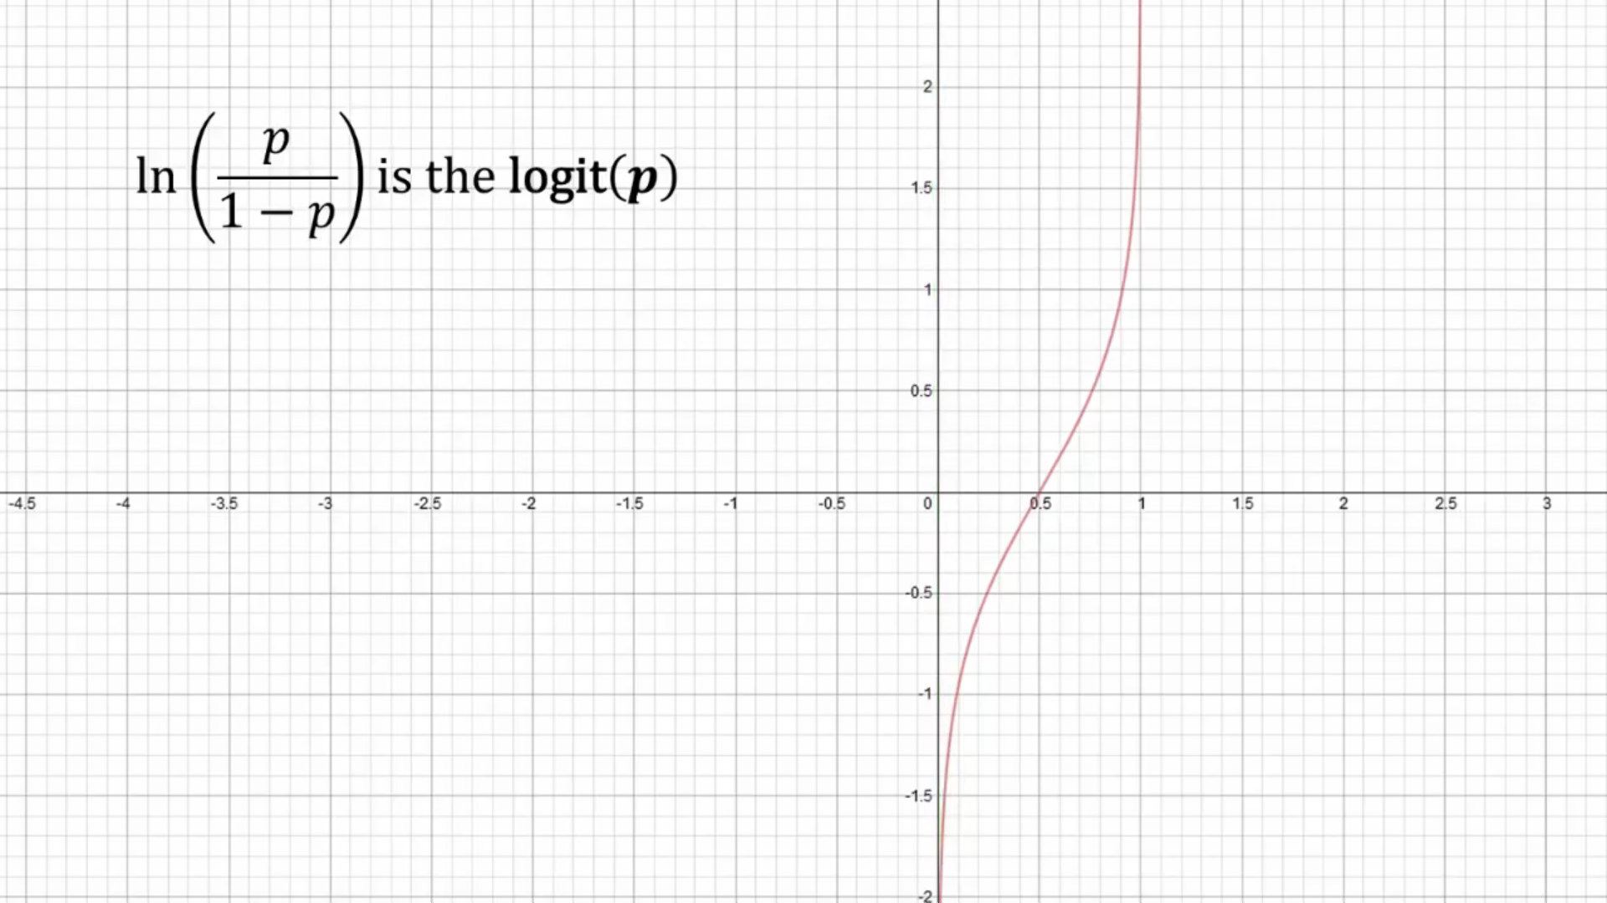

Slide 34
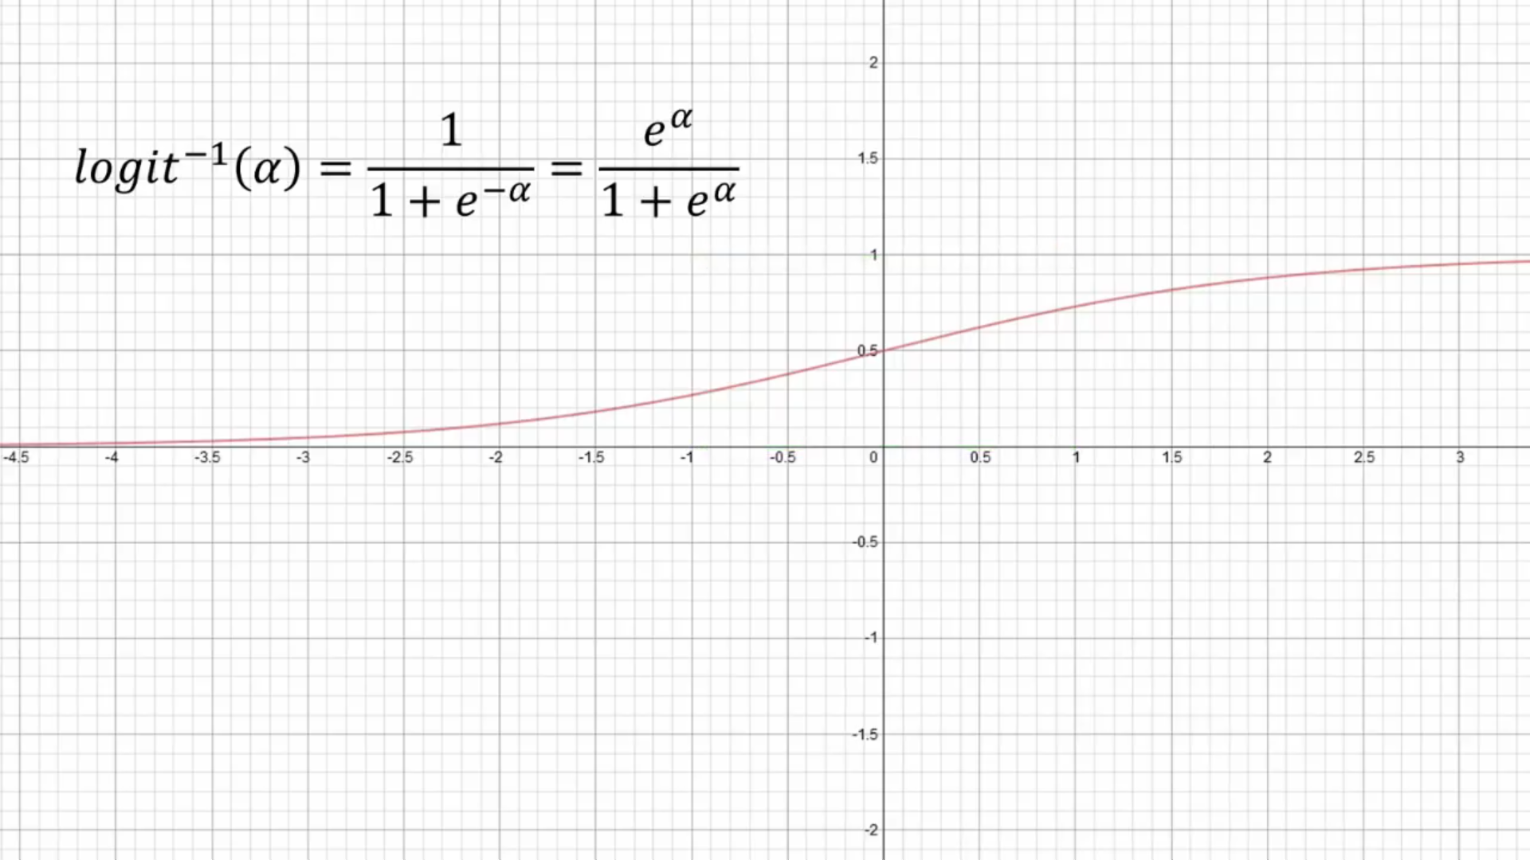

Slide 35
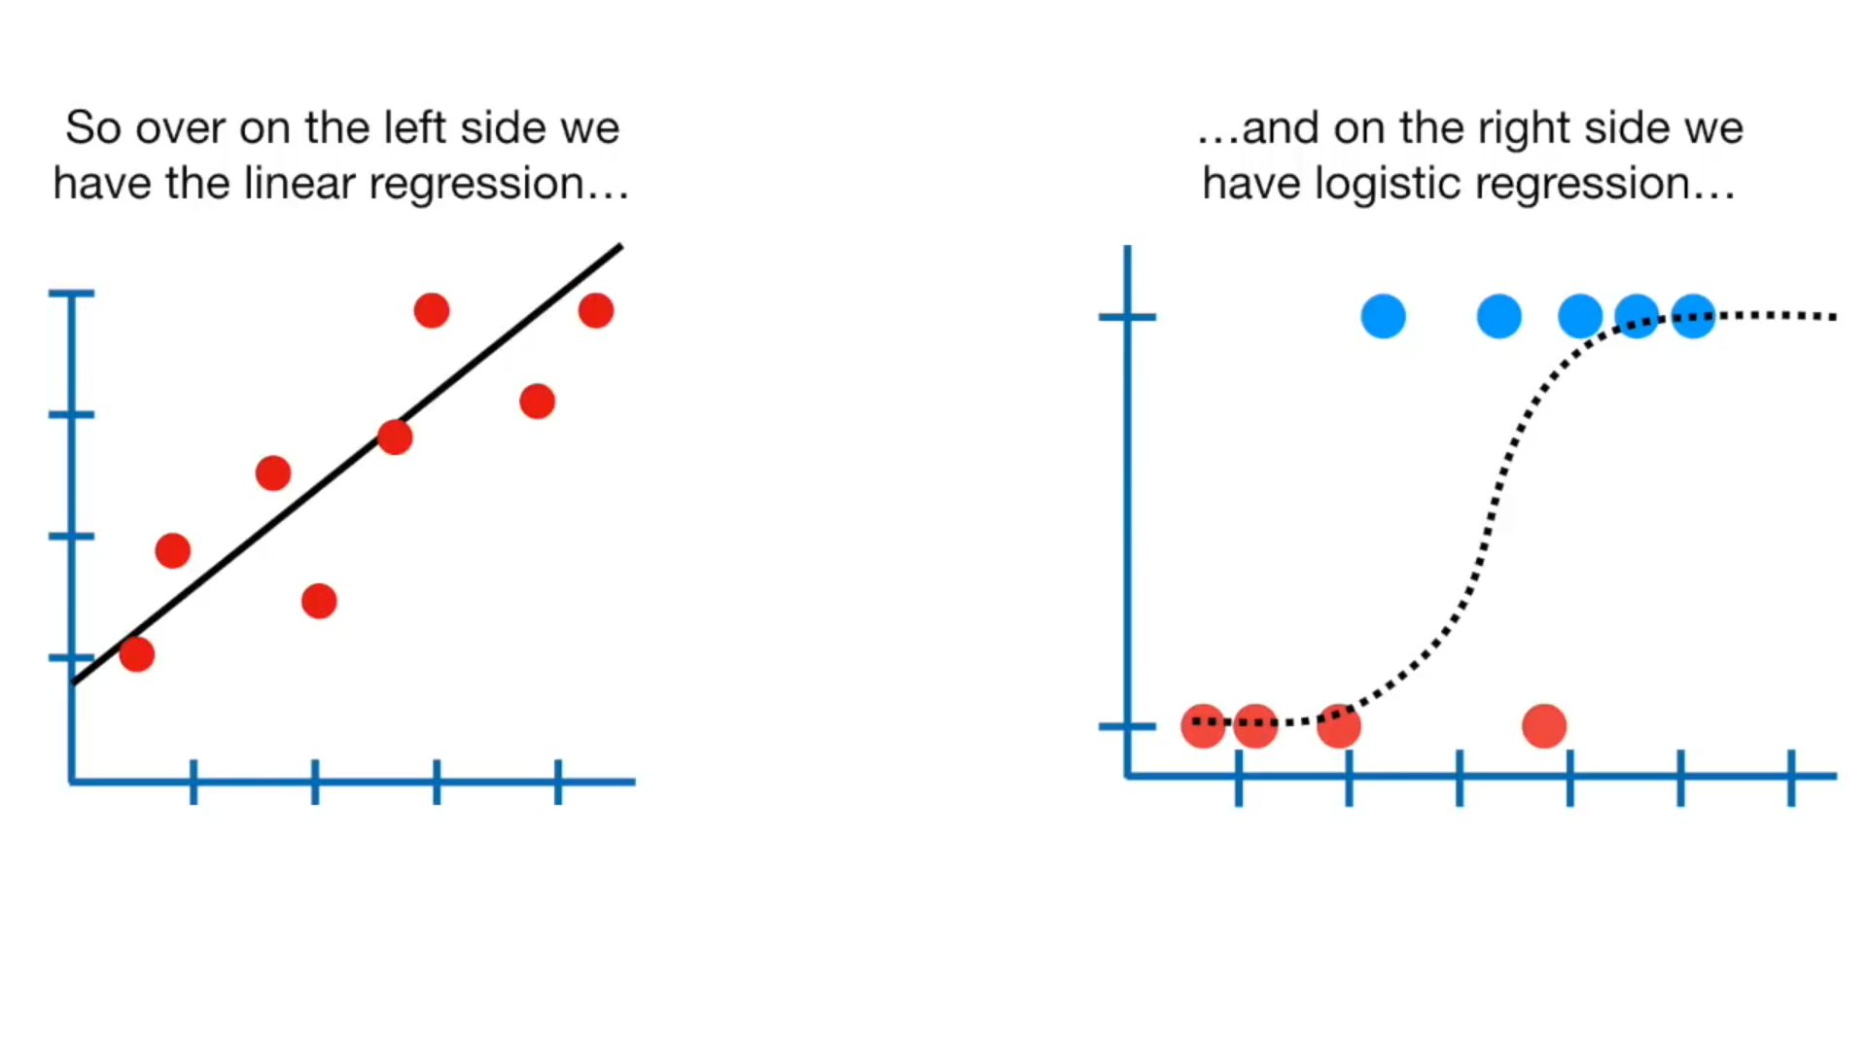

Slide 36
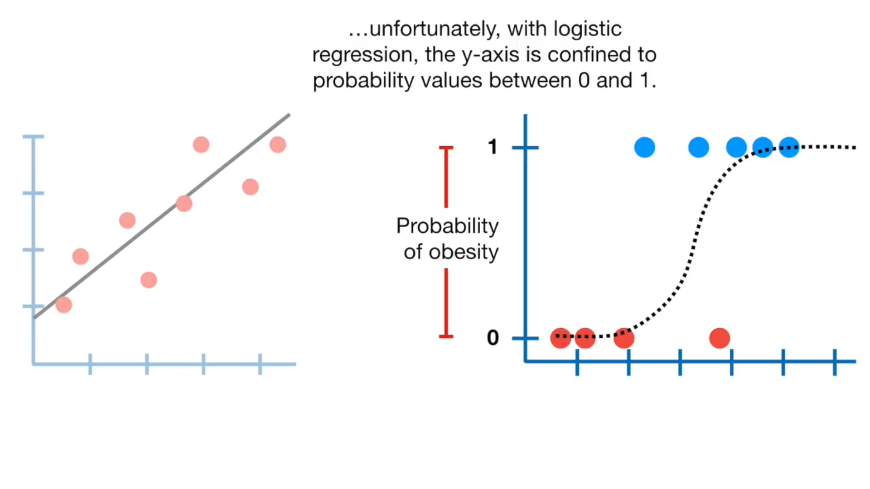

Slide 37
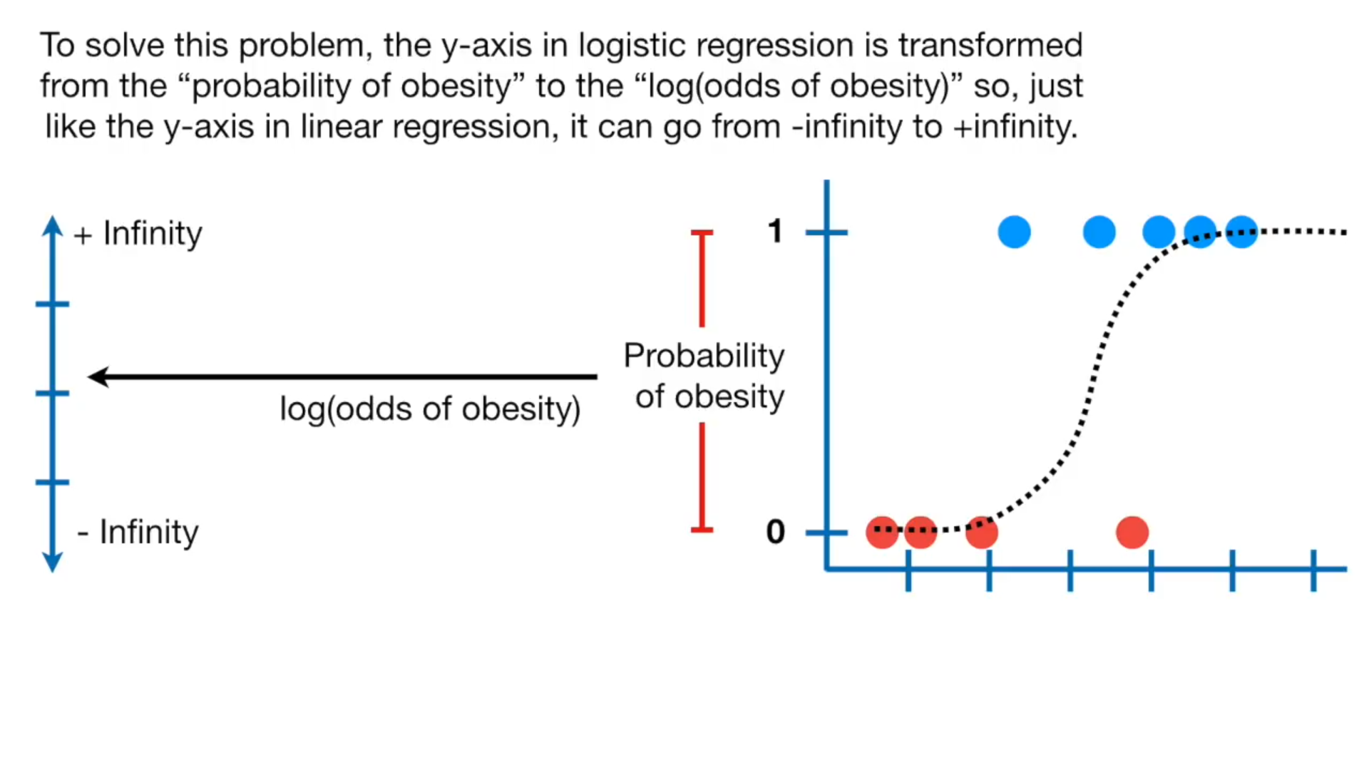

Slide 38
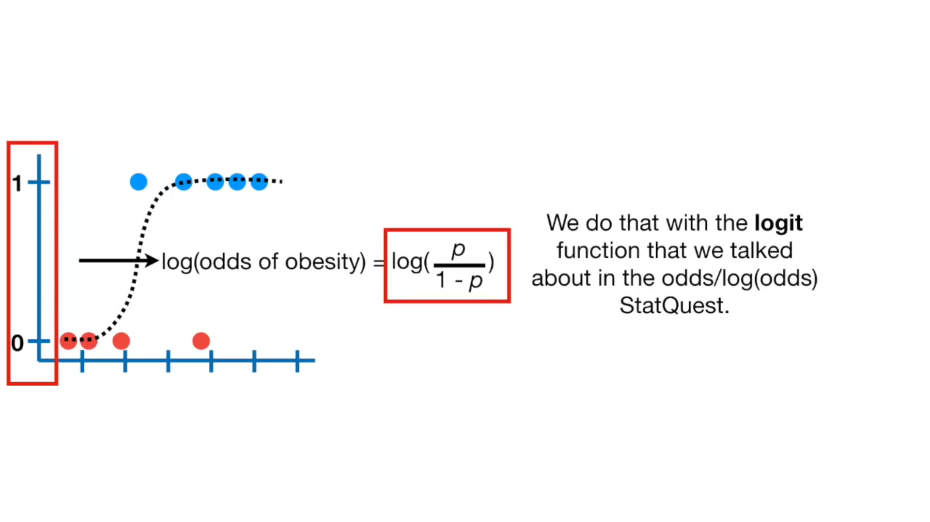

Slide 39
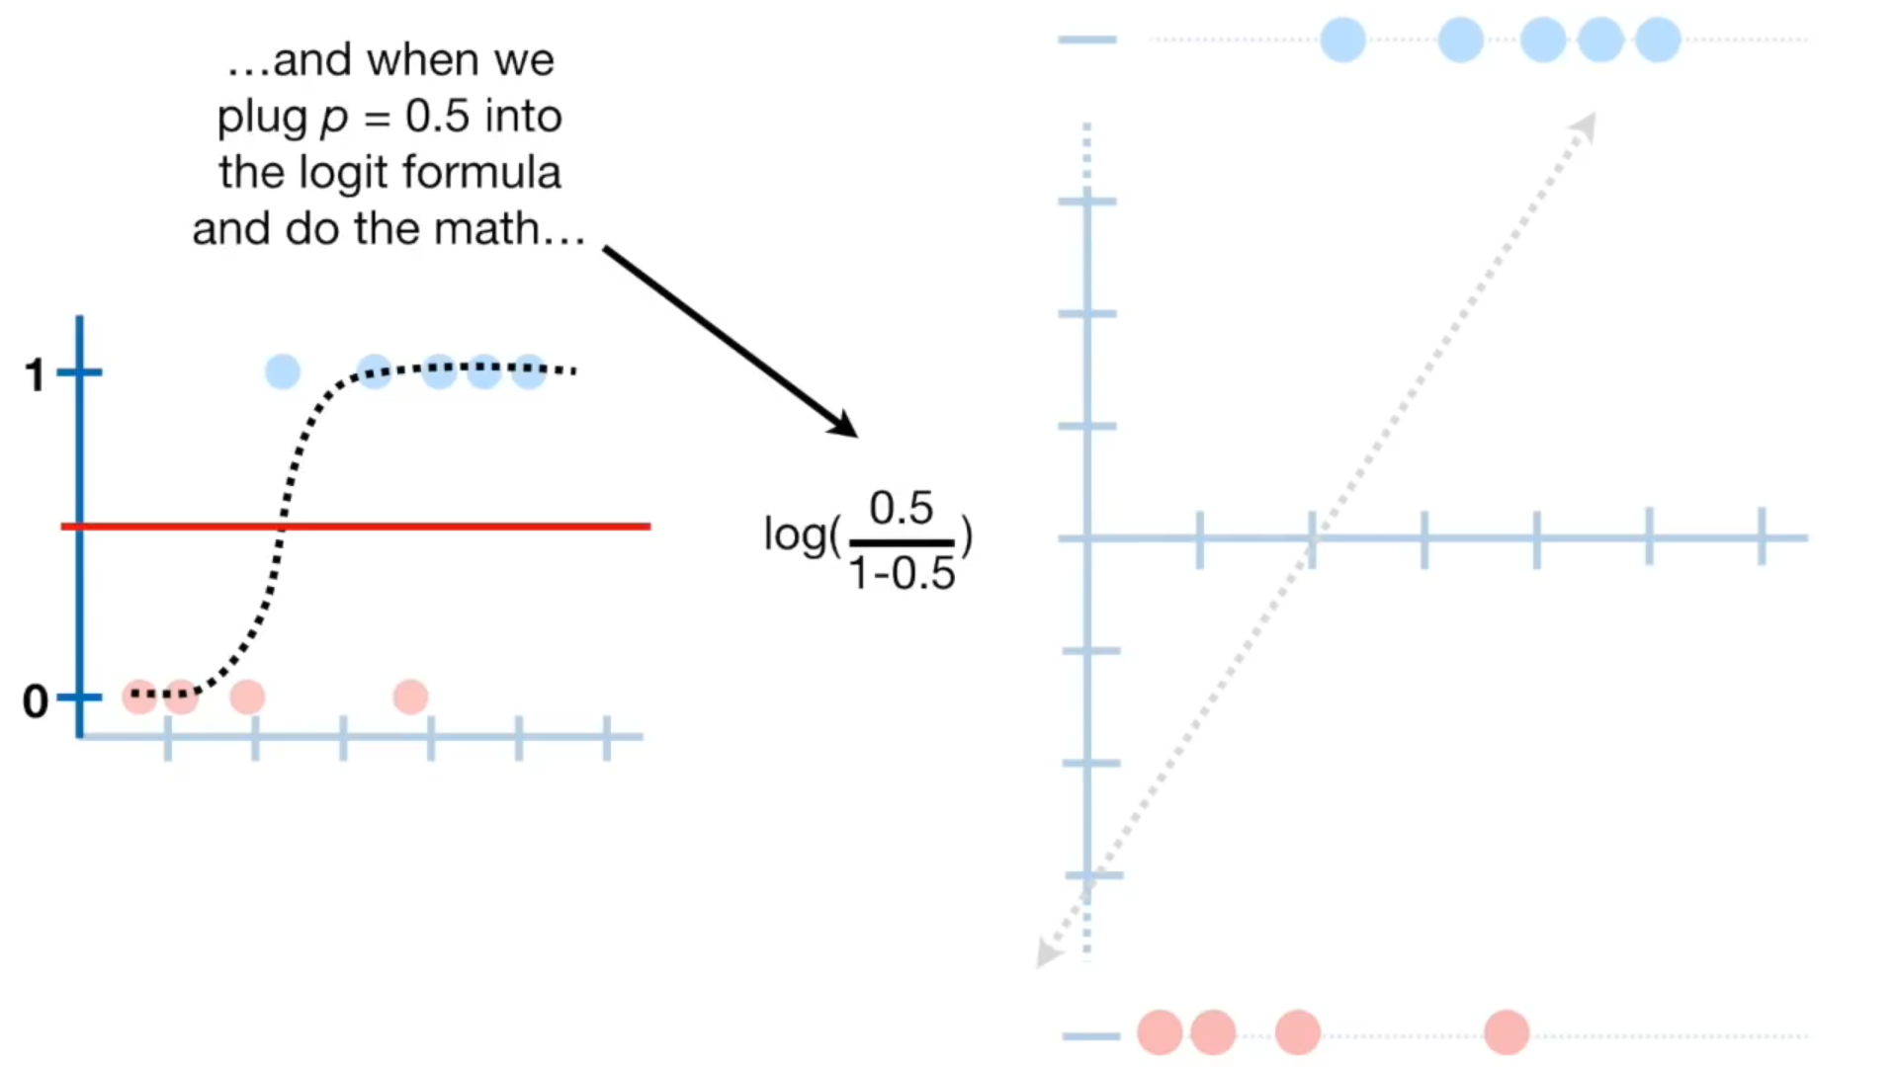

Slide 40
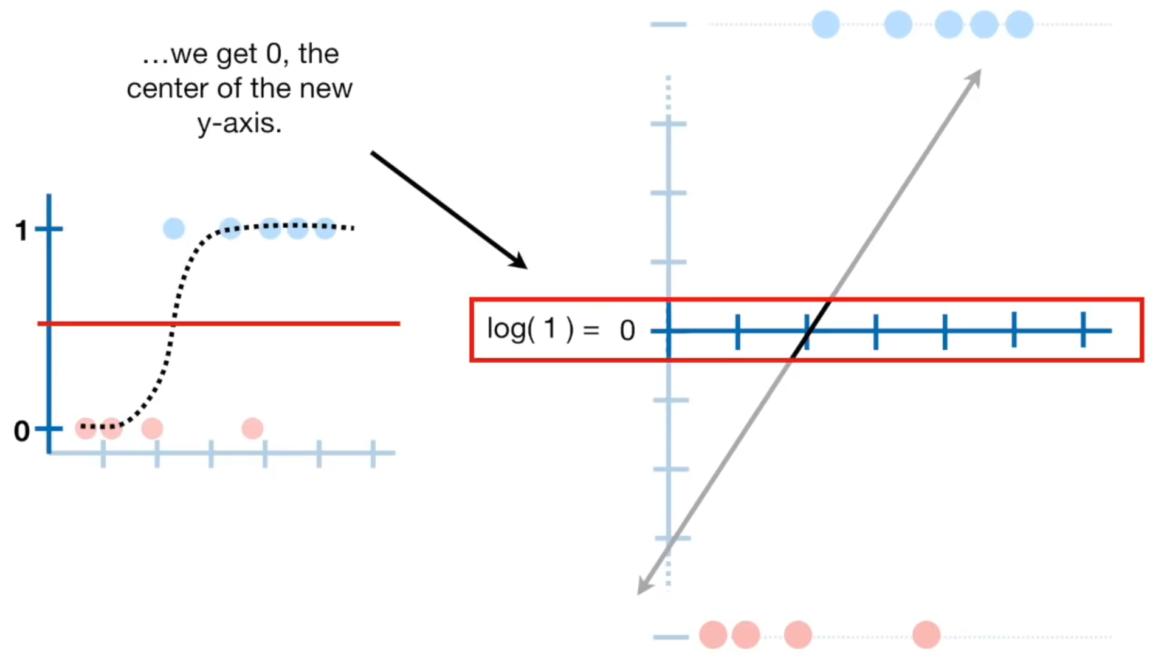

Slide 41
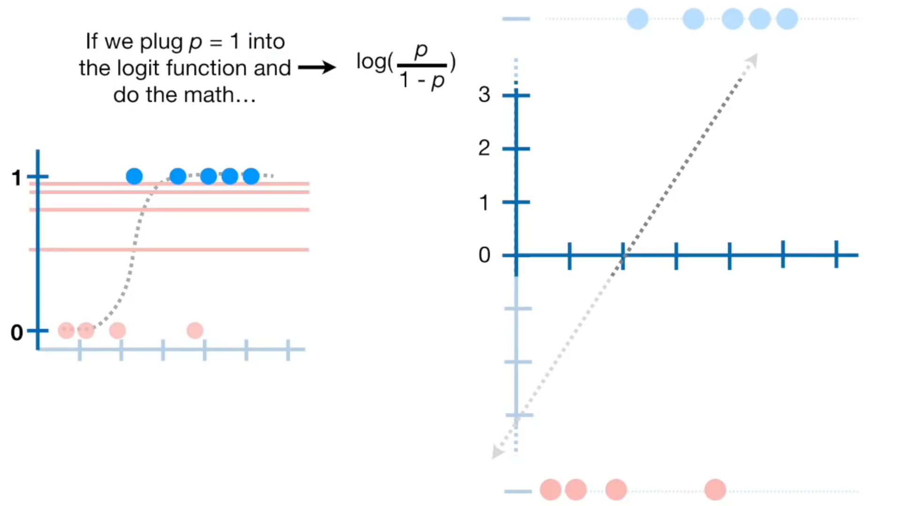

Slide 42
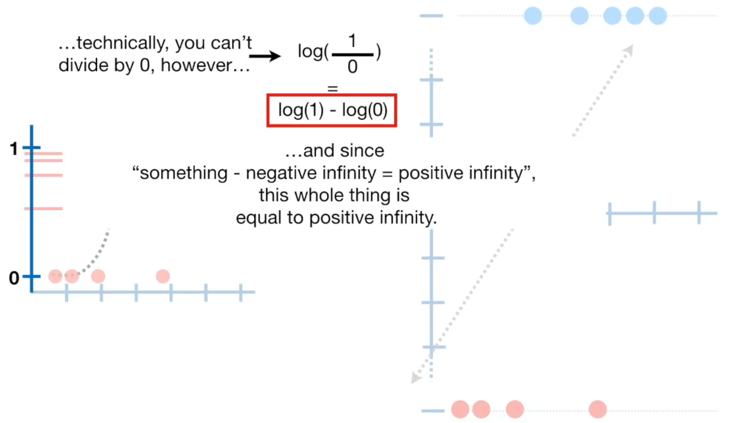

Slide 43
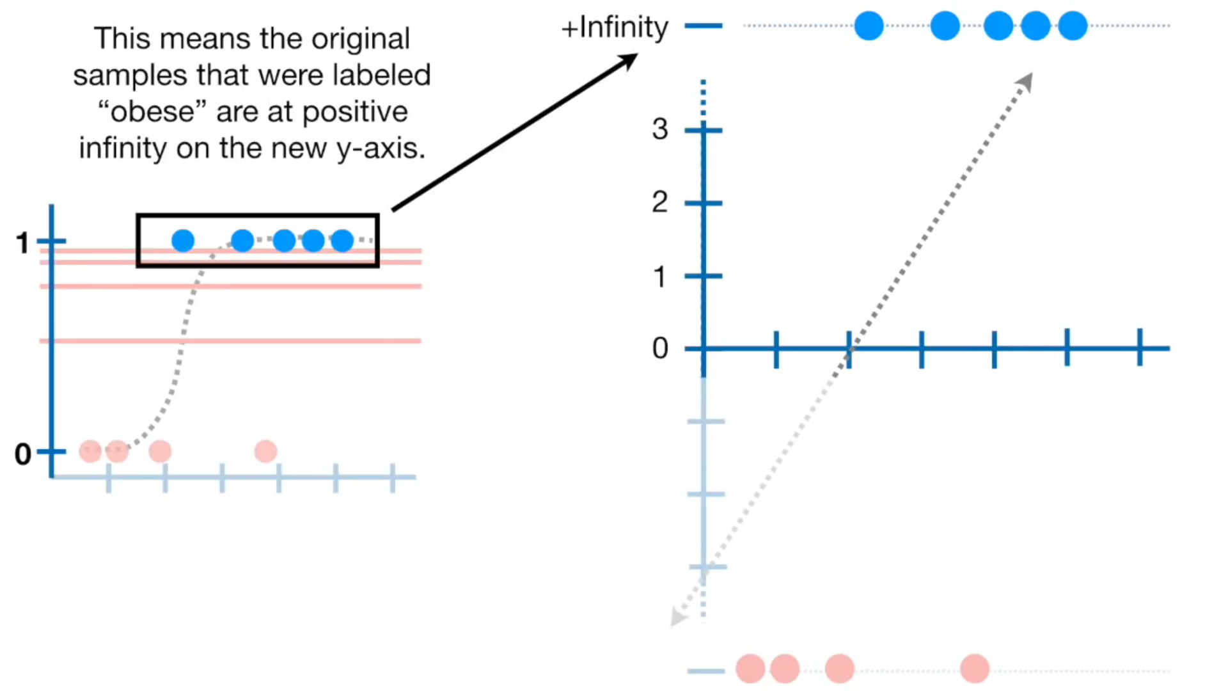

Slide 44
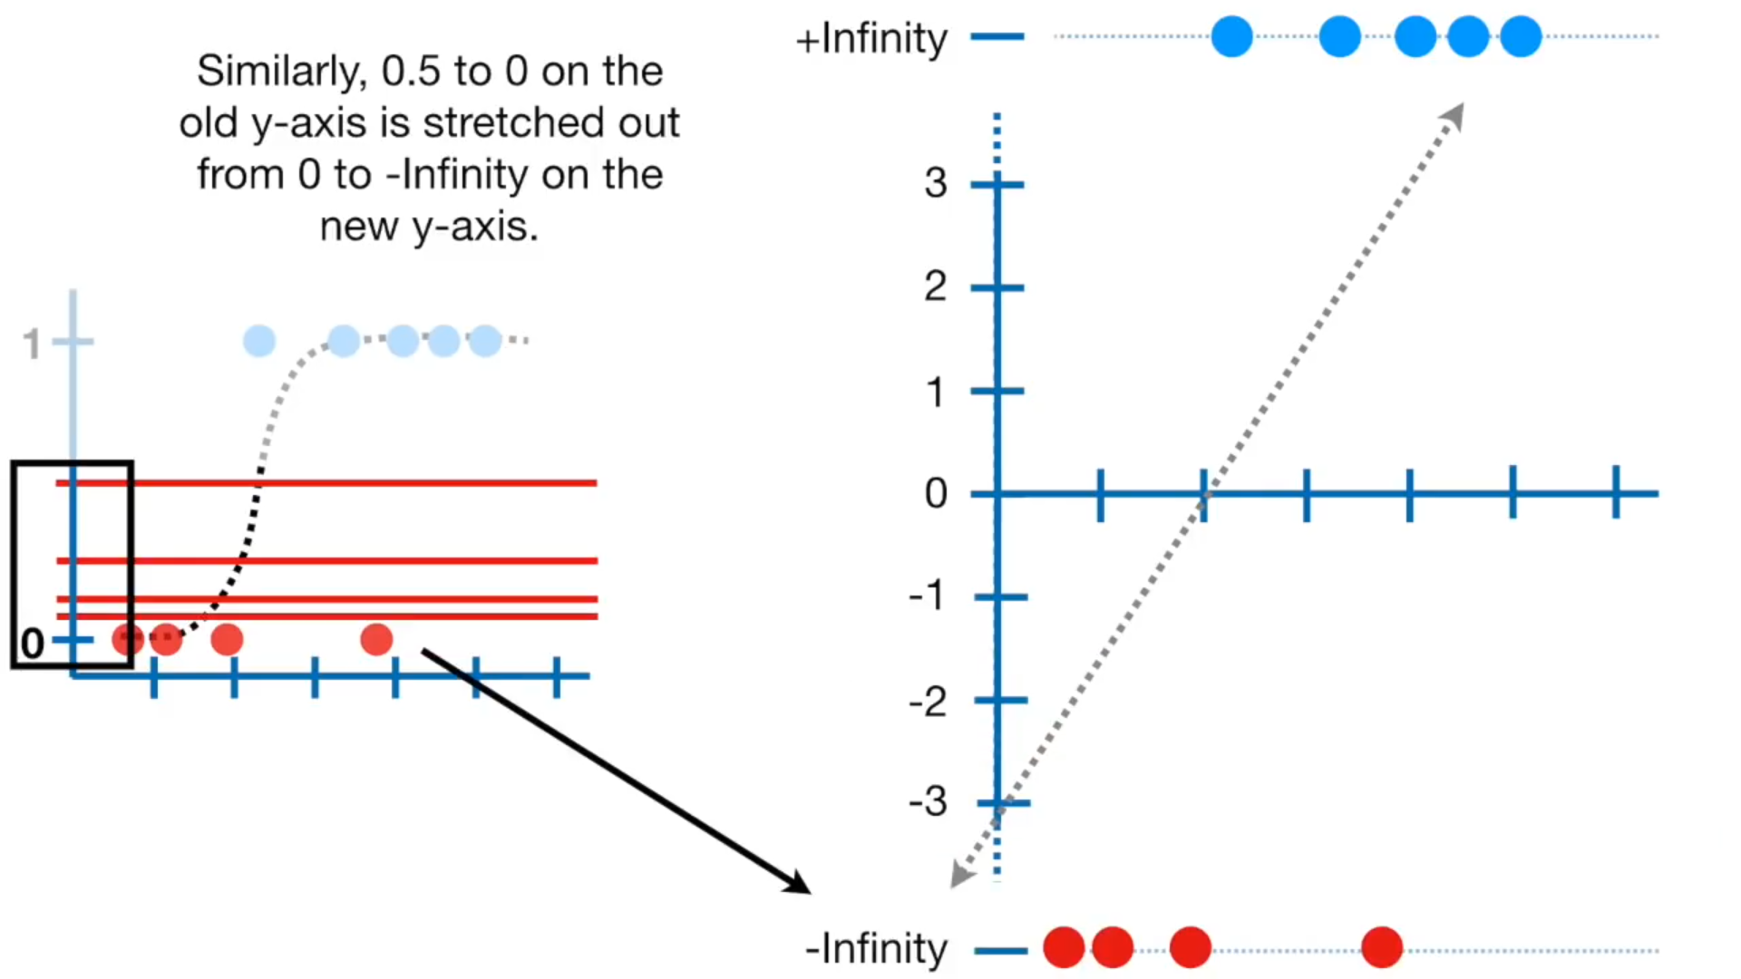

Slide 45
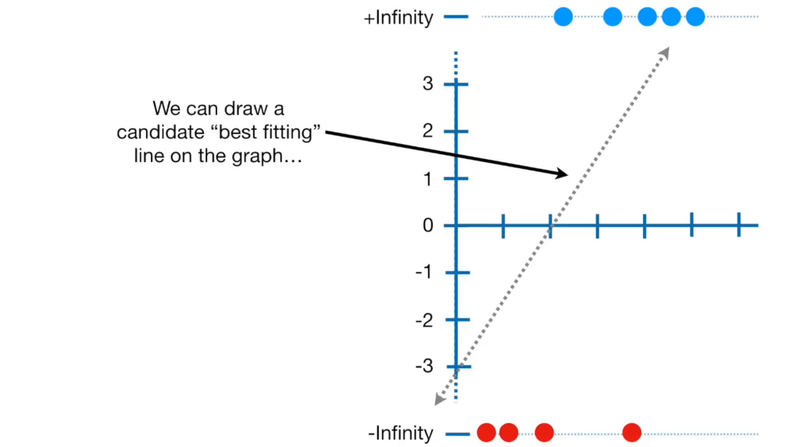

Slide 46
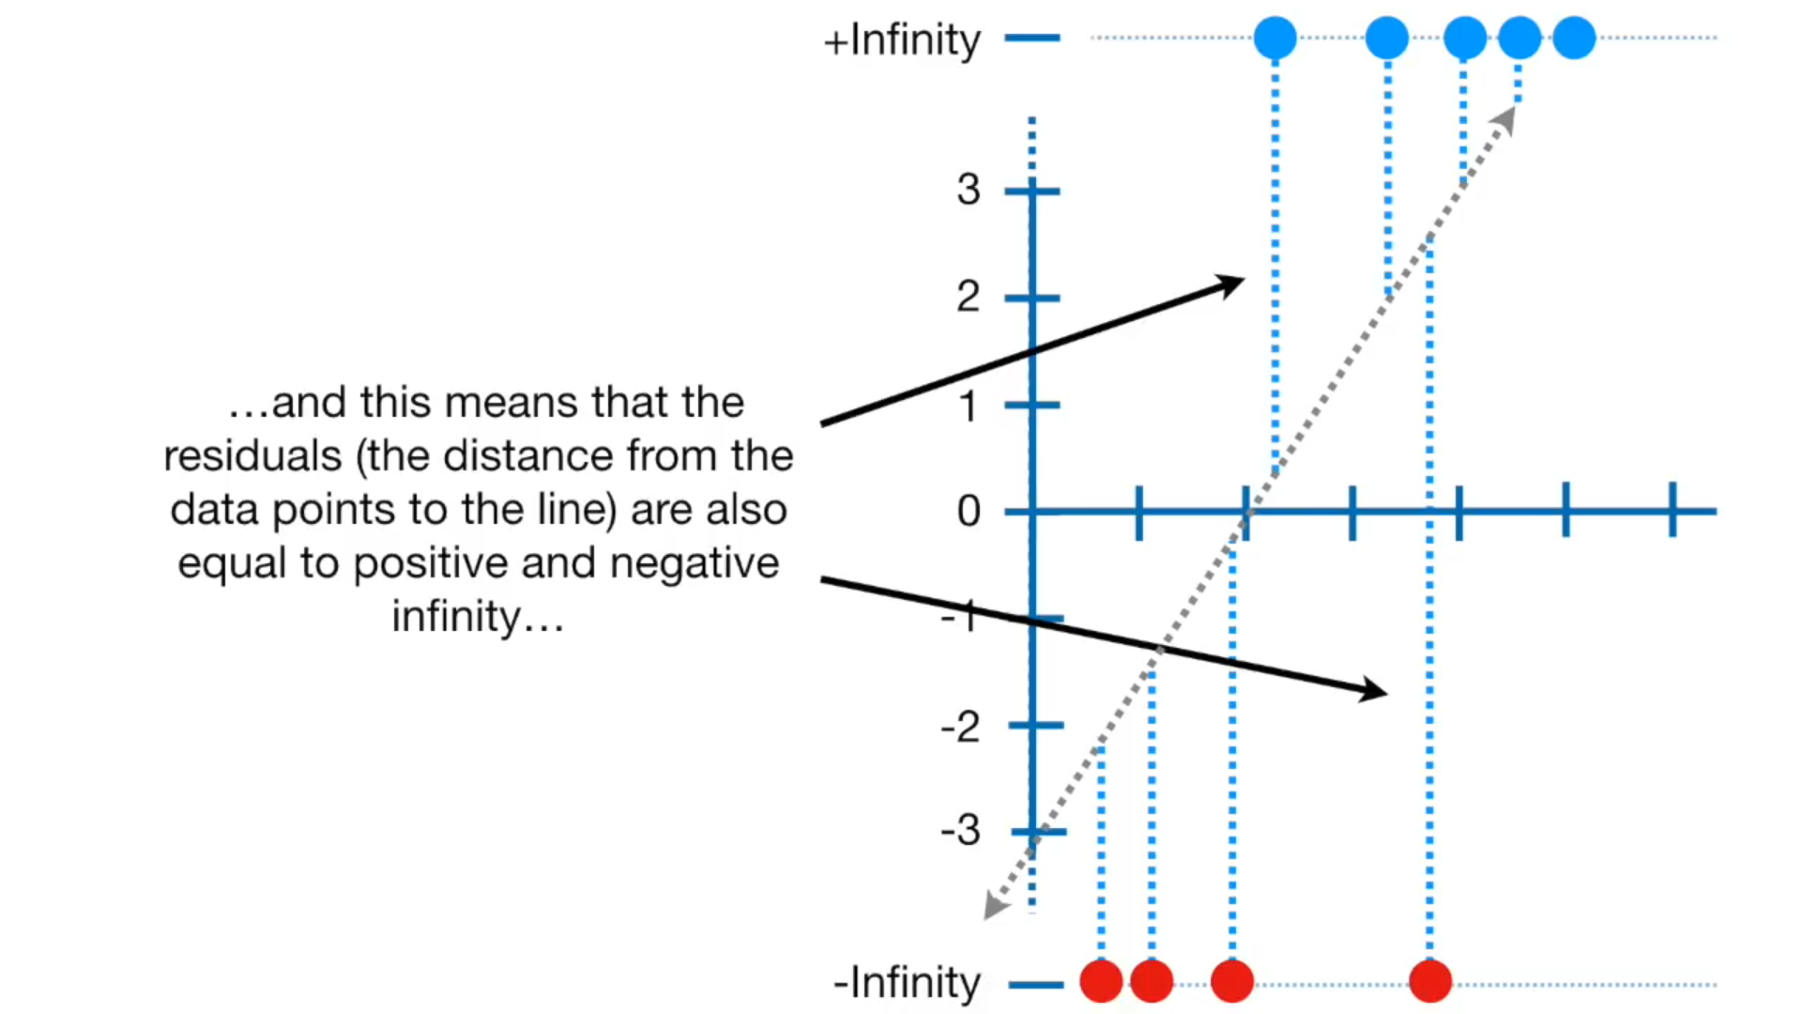

Slide 47
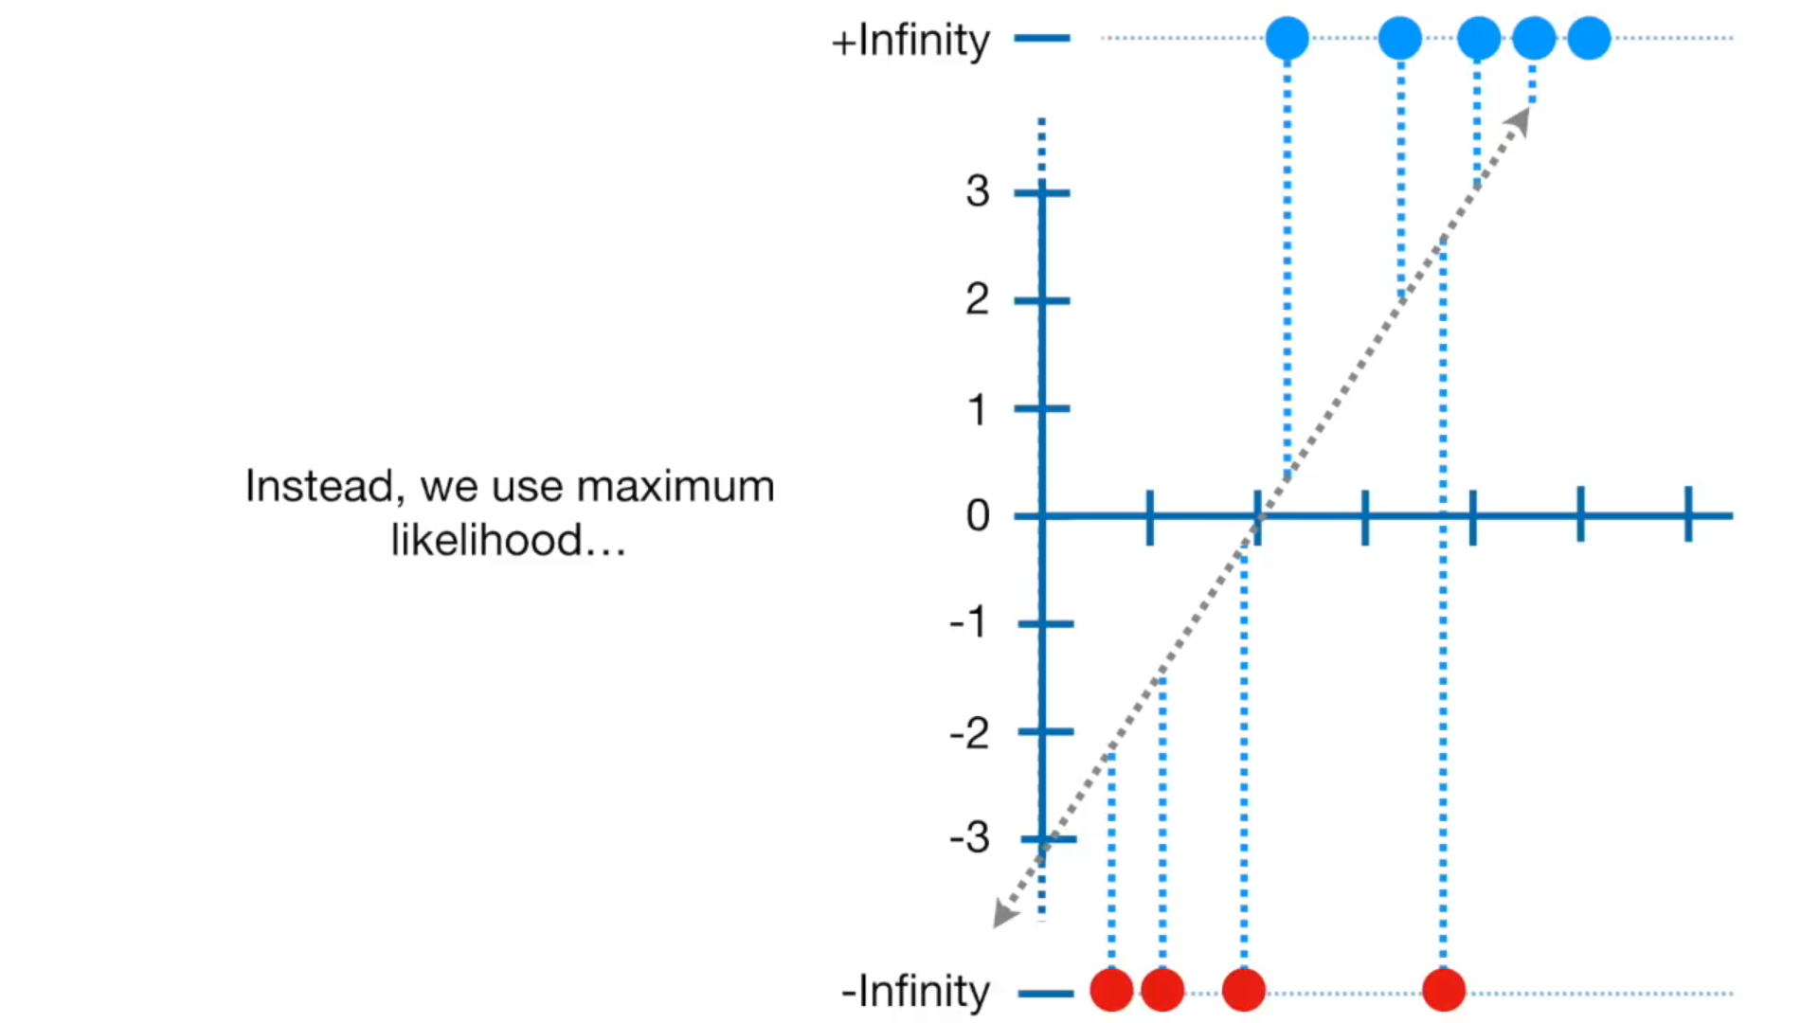

Slide 48
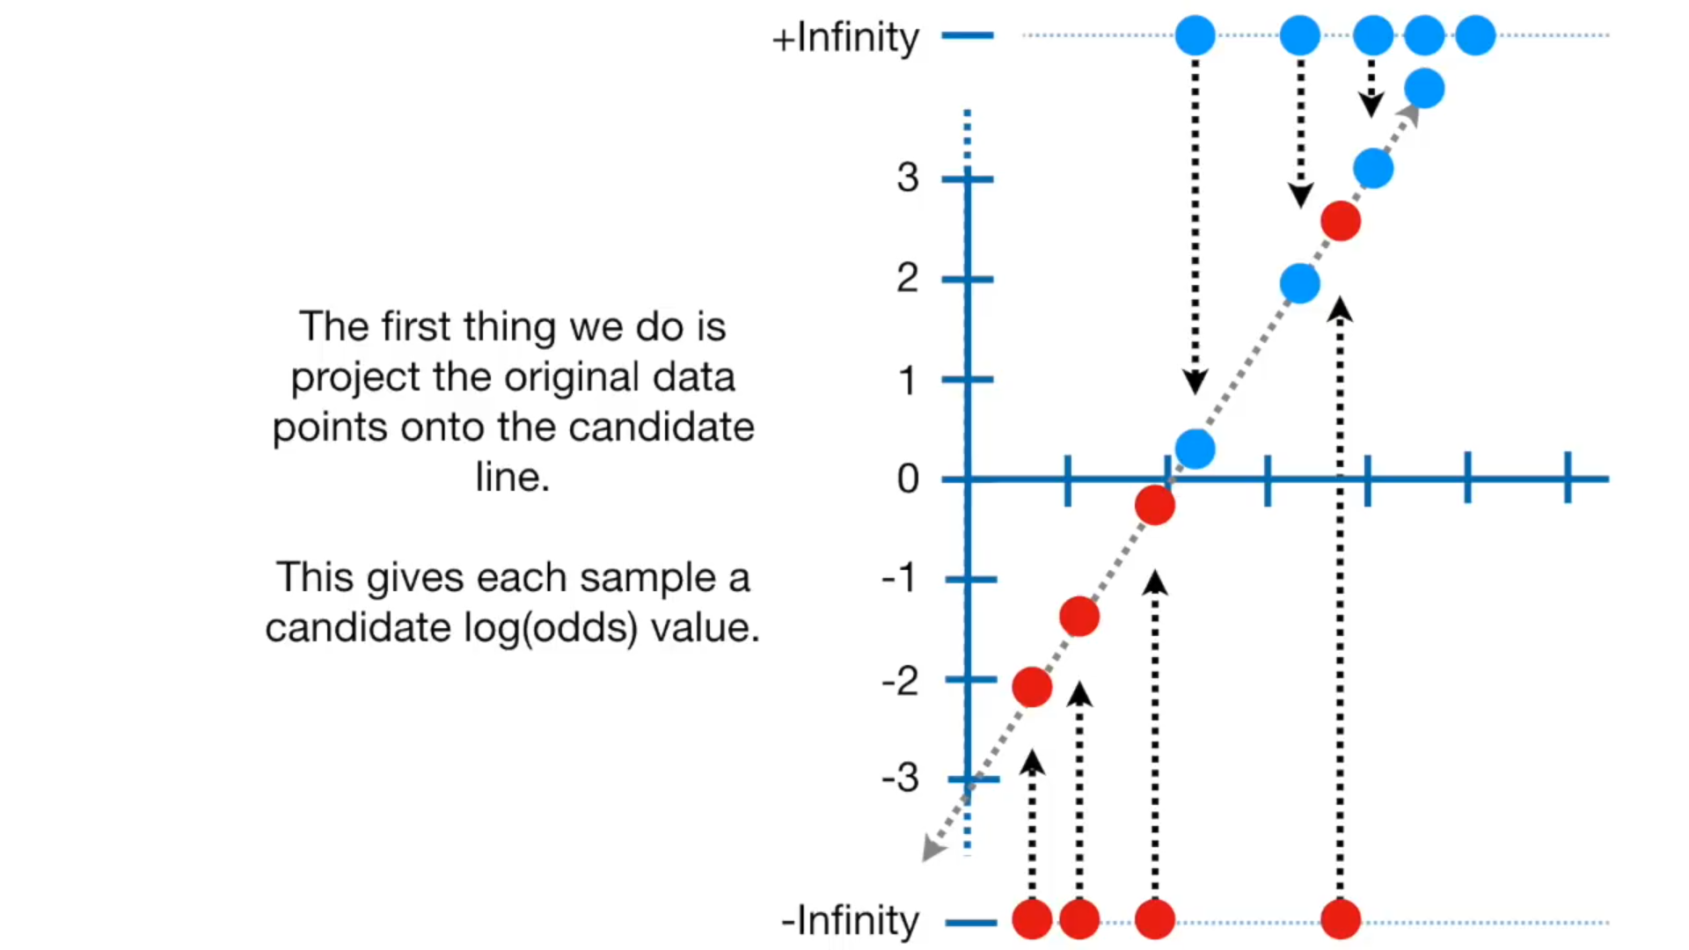

Slide 49
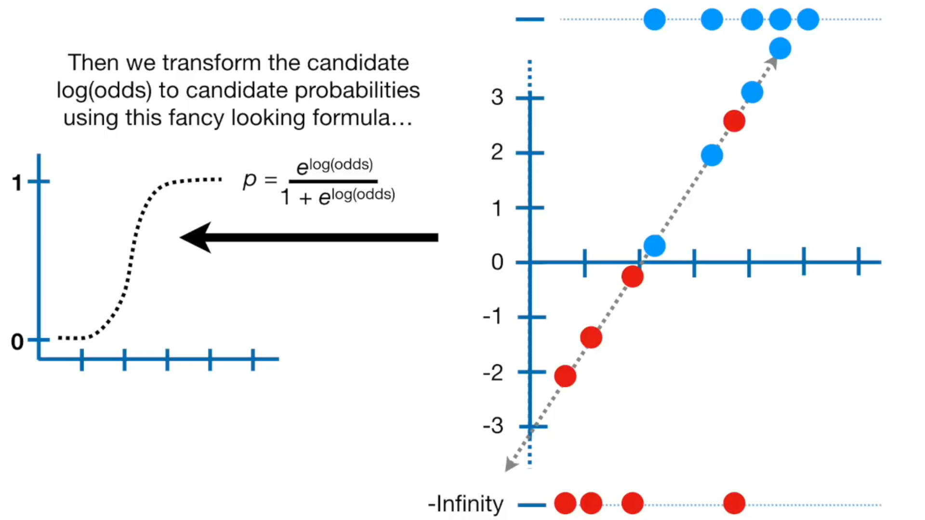

Slide 50
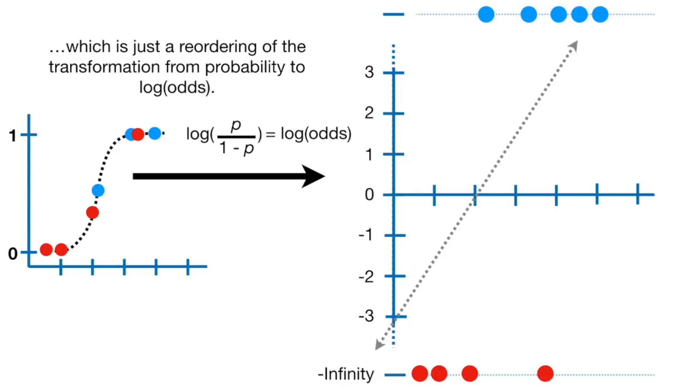

Slide 51
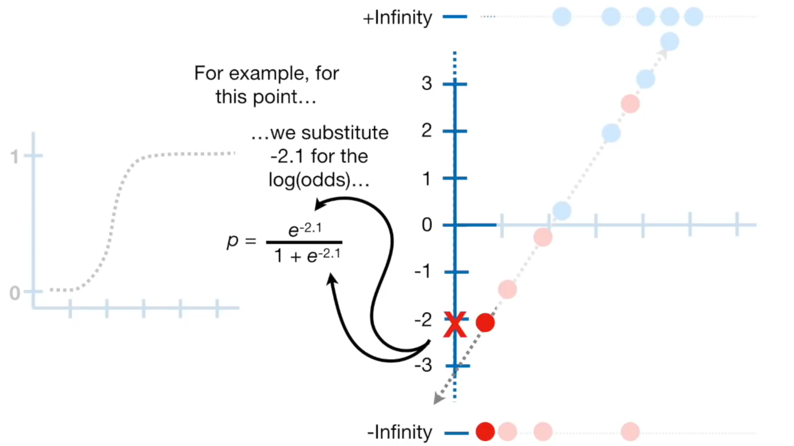

Slide 52
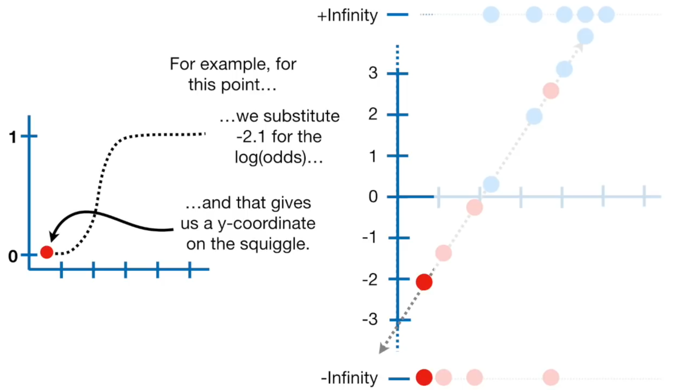

Slide 53
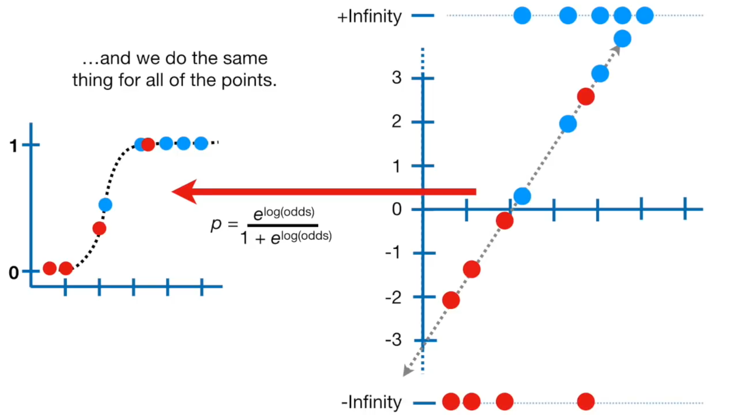

Slide 54
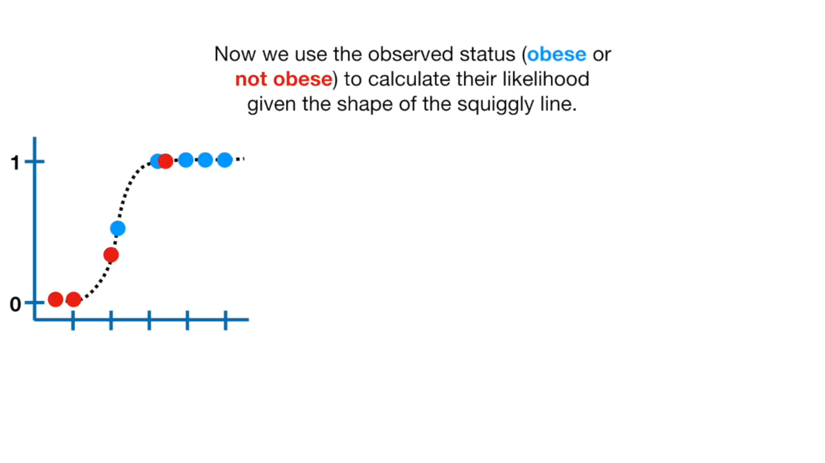

Slide 55
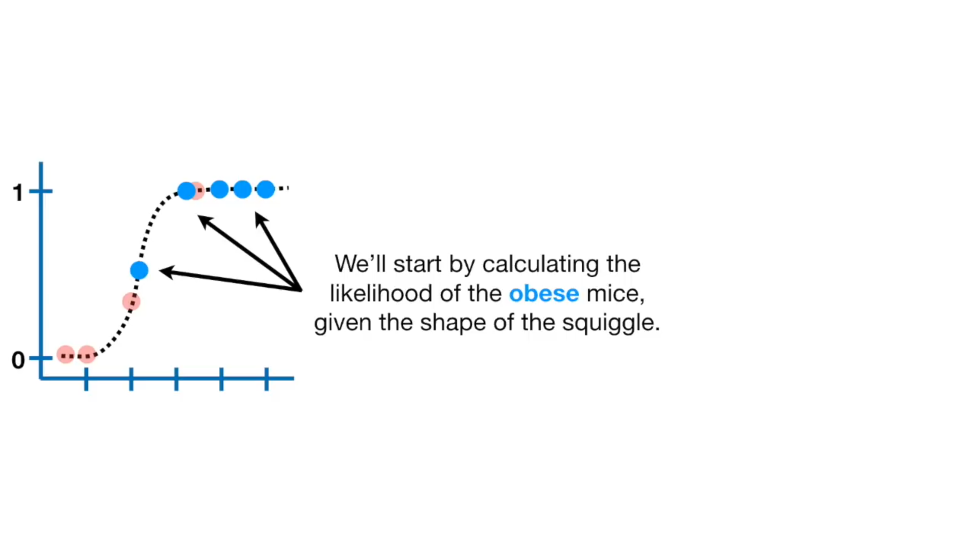

Slide 56


Slide 57


Slide 58


Slide 59


Slide 60


Slide 61


Slide 62


Slide 63


Slide 64


Slide 65


Slide 66


Slide 67


Slide 68


Slide 69


Slide 70


Slide 71


Slide 72


Slide 73


Slide 74


Slide 75


Slide 76


Slide 77



For samples labelled as 1 : $\prod_{y_{i}=1}{ p(x_{i})}$ For samples labelled as 0 : $\prod_{y_{i}=0}{ (1 − p(x_{i}))}$ L($β$) = $\prod_{y_{i}=1}{ p(x_{i})}$ * $\prod_{y_{i}=0}{ (1 − p(x_{i}))}$ L($β$) = $\prod{ ( {p(x_{i})}^{y_{i}}}$ * ($1 − {p(x_{i})}^{1−y_{i}}$) ) $ℓ(β)$ =$\sum_{i=0}^{m}{ y_{i}} log⁡(p(x_{i})$) + (1 - $y_{i}$) $log⁡(1 −p(x_{i})$)
The likelihood function,
we want to maximize it.
L($β$) = $\prod_{y_{i}=1}{ p(x_{i})}$ * $\prod_{y_{i}=0}{ (1 − p(x_{i}))}$
The Log-likelihood function.
$ℓ(β)$ =$\sum_{i=0}^{m}{ y_{i}} log⁡(p(x_{i})$) + (1 - $y_{i}$) $log⁡(1 −p(x_{i})$)

Slide 78
We combine the previous two sections into one equation. So, the cost function will be : J($θ$) = - $\frac{1}{m}$ $\sum_{i=0}^{m}{ y_{i}} log⁡(h_{β}$($x$)) + (1 - $y_{i}$) $log⁡(1 − h_{β}$($x$))

Slide 79
J($β$) = - $\frac{1}{m}$ $\sum_{i=0}^{m}{ y_{i}}\text{.}β\text{.}x_{i}$ - $log⁡(e^{z}+1$) So, the derivative will be : $∇_{β}$ J = - $\frac{1}{m}$ $∇_{β}$ $\sum_{i=0}^{m}{ y_{i}}\text{.}β\text{.}x_{i}$ - $log⁡(e^{β\text{.}x_{i}}+1$) = - $\frac{1}{m}$ $\sum_{i=0}^{m}{ y_{i}}\text{.} x_{i}$ - $\frac{1}{1+e^{β\text{.}x_{i}}}$ * $e^{β\text{.}x_{i}}$ * $x_{i}$ = - $\frac{1}{m}$ $\sum_{i=0}^{m}{ ( y_{i}}$ - $\frac{e^{β\text{.}x_{i}}}{1+e^{β\text{.}x_{i}}}$ ) . $x_{i}$ = - $\frac{1}{m}$ $\sum_{i=0}^{m}{ ( y_{i}}$ - $p(x_{i})$ ) . $x_{i}$ = - $\frac{1}{m}$ $\sum_{i=0}^{m}{ ( y_{i}}$ - ${\hat{y}}_{i}$ ) . $x_{i}$ = ${\text{− }\frac{1}{m}X}^{T}$ . ( $Y$- $\hat{Y}$ )
(1)
is a $sigmoid$
for a matrix notation.

Slide 80





Gradient Descent Algorithm
$\text{w} ≔ \text{w} −$𝛼 $\frac{∂ }{∂\text{w}}$ $J(\text{w} , b)$
$J$ $(\text{w}\text{, }\text{b} )$
(𝛼) => learning rate
$\text{b} ≔ \text{b} −$𝛼 $\frac{∂ }{∂\text{b}}$ $J(\text{w} , b)$
($\text{β}$ )

Slide 81


Slide 82


Slide 83


Slide 84



